Slide 1
Family & Guardian Guide
to Microsoft Teams
Everything your student needs to know to get started with online learning.

Slide 2
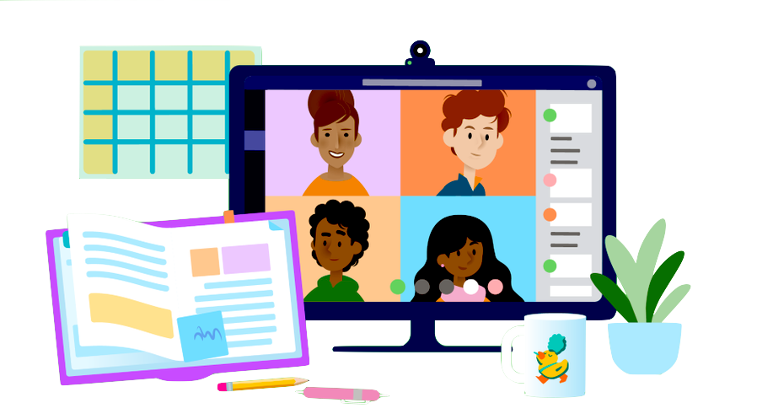
Dear families and guardians,
We hear you. Your involvement in your student’s education is more important than ever. On top of juggling work and personal responsibilities and ensuring that your family stays safe and healthy, you’re now assisting with remote learning. You have a lot on your plate.
We’re here to help. This guide will cover how to set up and get started using Microsoft Teams so that your student can continue learning and connecting with their teacher and class. You’ll learn why 75 million people around the world choose Microsoft Teams every day.
Ask us anything..If you have questions, comments, or suggestions about this guide, please fill out this form: aka.ms/FamilyGuideFeedback

Slide 3
Table of Contents
Chapter 1: Get Started with Teams
Sign into Teams online
Download Teams on desktop
Download Teams on mobile device
Chapter 2: How to help your student use Teams
Join a class team
View and turn in assignments
Attend a virtual class
Find grades
Chat with teachers and classmates
Chapter 3: FAQ & Troubleshooting
My student’s login isn’t working.
I can’t find my student’s class during set-up.
My student’s assignments are missing.
My student missed a class—what now?
What if I have more than one student using Teams?
What do I do if we have low internet bandwidth?
Audio troubleshooting
Additional resources

Slide 4
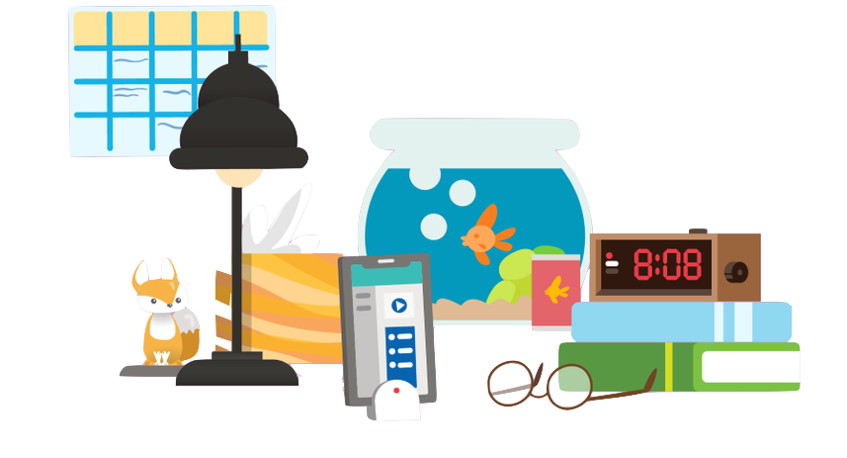
Sign into Teams online
Chapter 1
Get started with Teams
Sign into Teams online
Download Teams on desktop
Download Teams on mobile device

Slide 5

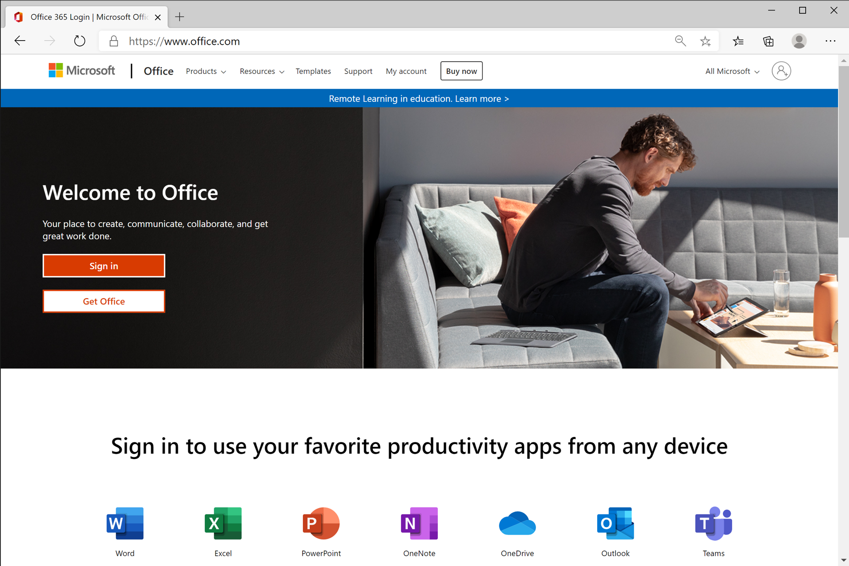
Go to Office.com and click Sign In.

Slide 6
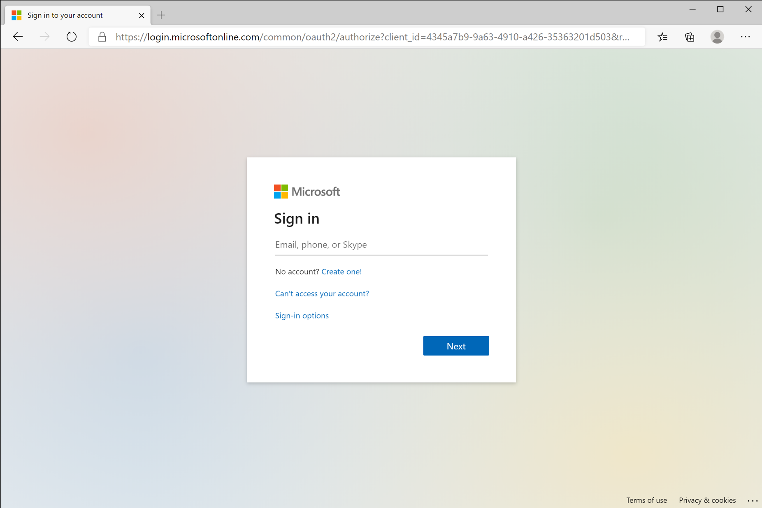
Sign in with your student’s school or work account. (This is how your student logs into their computer at school.)

Slide 7
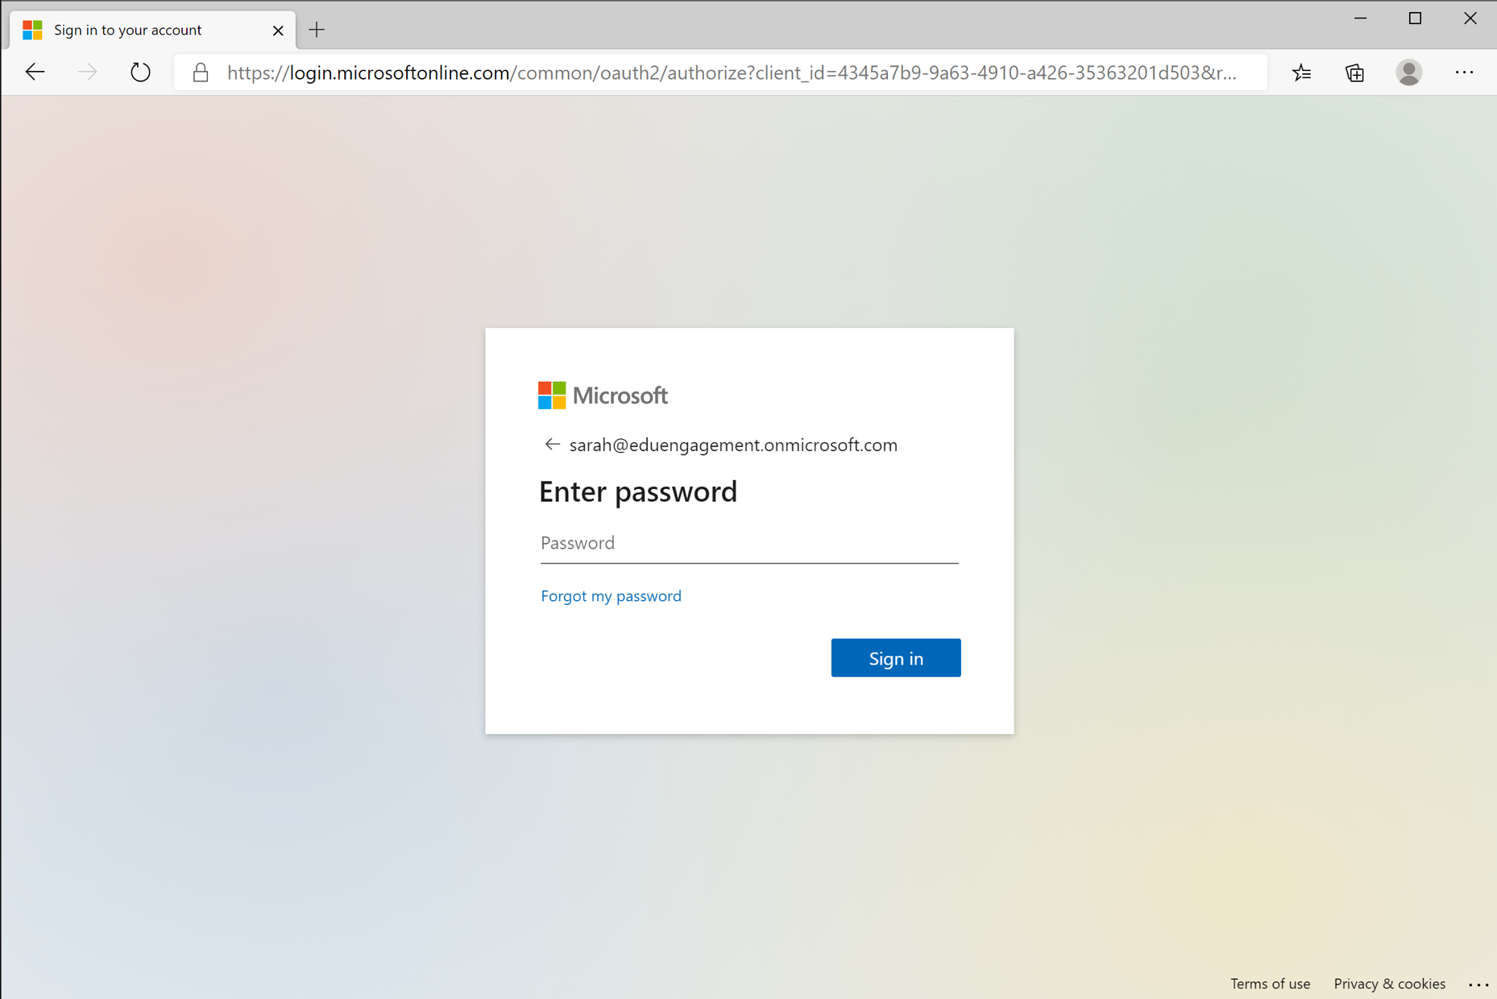

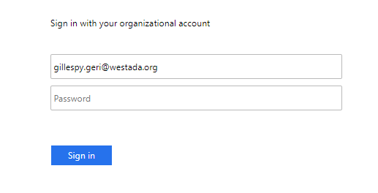
Username
Password
You may be asked to log in with your district information before being redirected to the password prompt.

Slide 8
Enter your student’s school password.

Slide 9
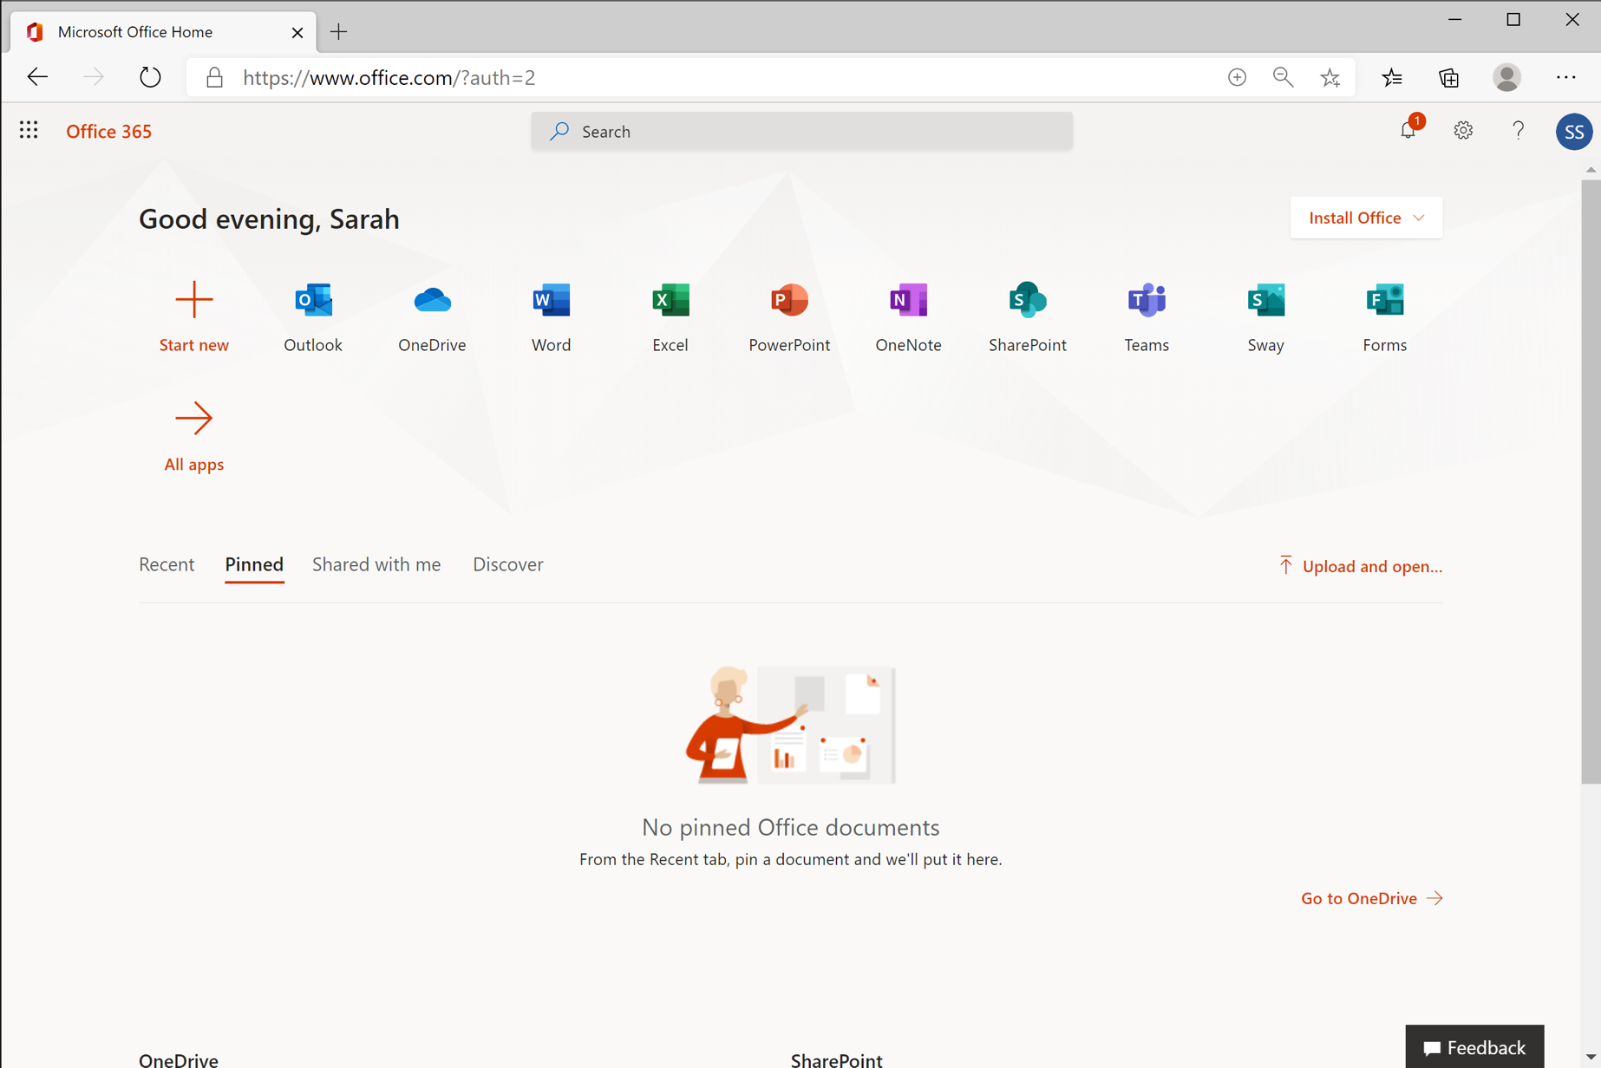
Select the Teams application to start using Teams online.

Slide 10
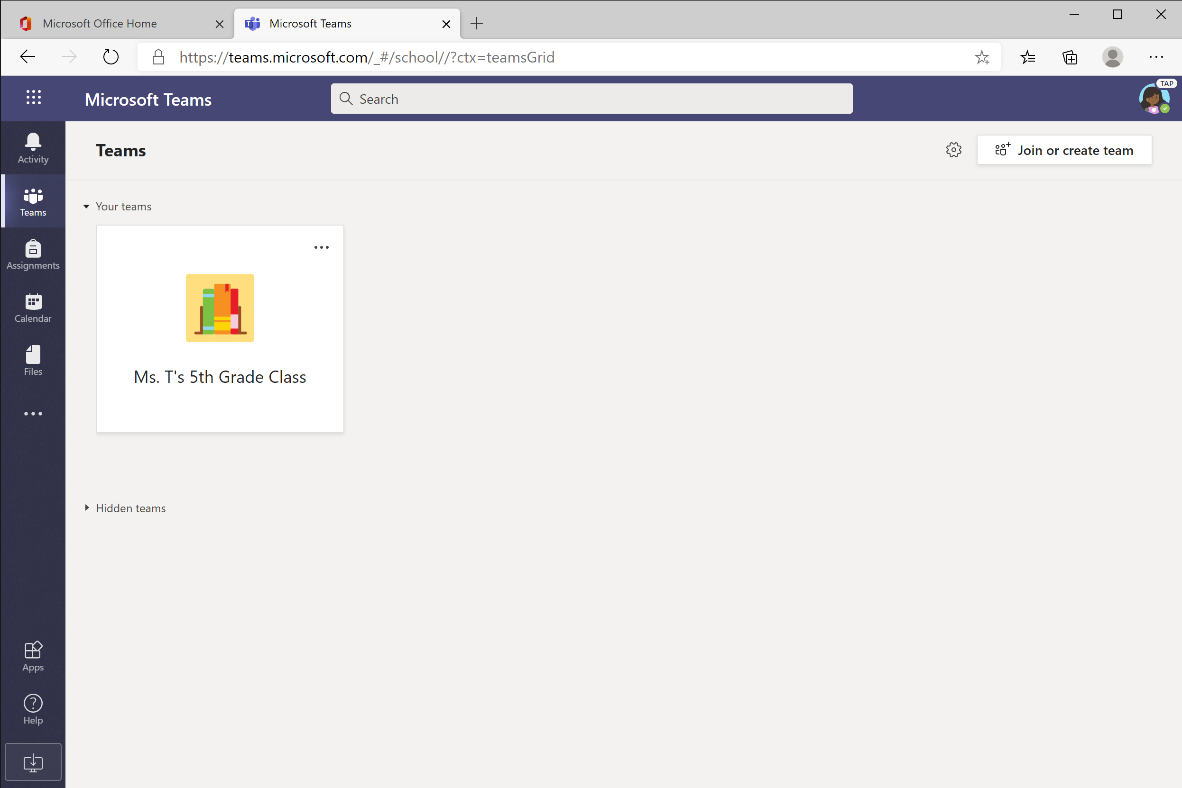


You’re ready to use Teams!

Slide 11
Download Teams on desktop
Chapter 1
Get started with Teams
Sign into Teams online
Download Teams on desktop
Download Teams on mobile device

Slide 12

Rather work on your desktop? Click this icon to download Teams. Jump to instructions for Windows or Mac.

Slide 13
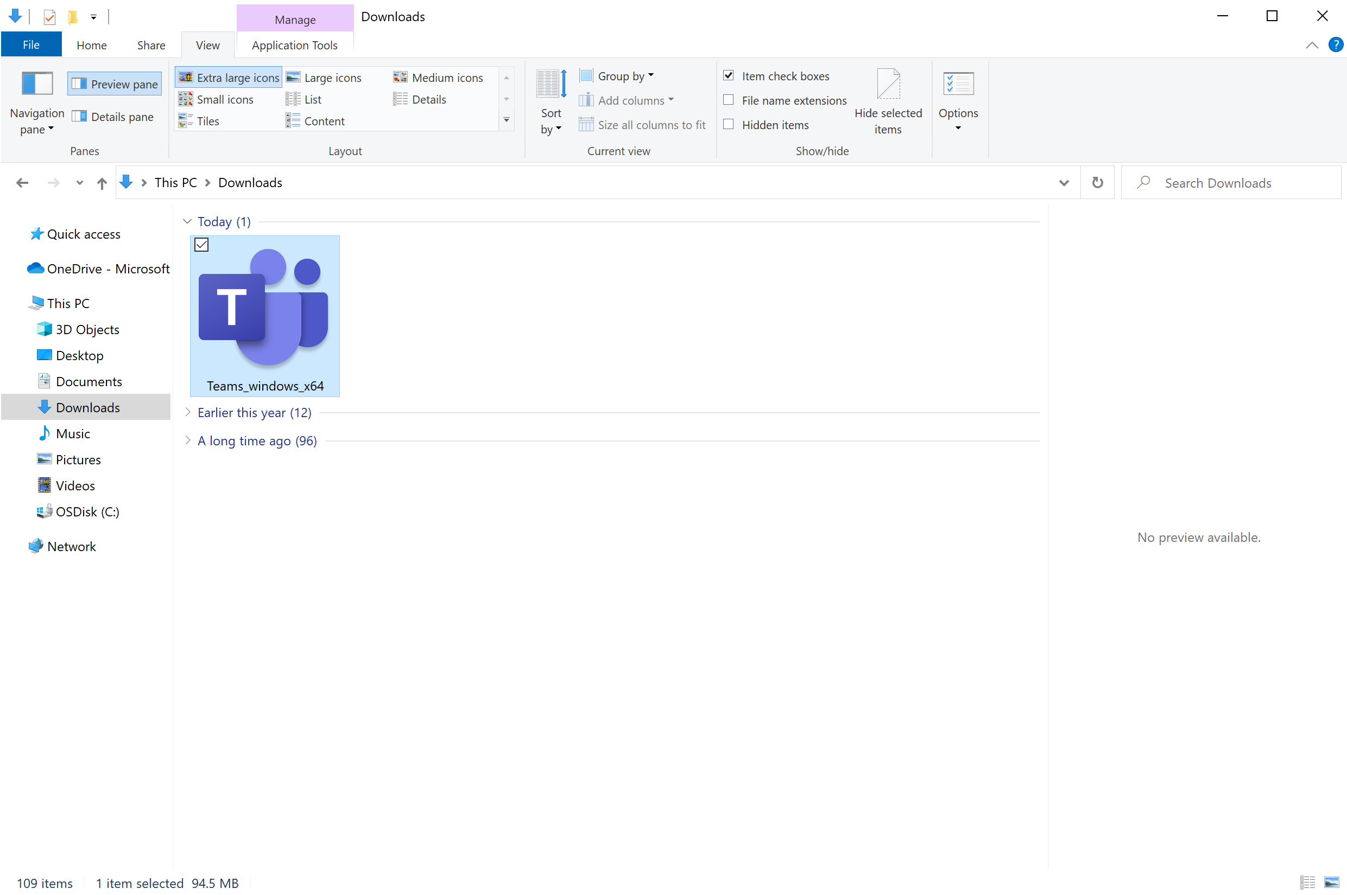
Windows: Find Teams file in Downloads folder. Double-click to launch.

Slide 14
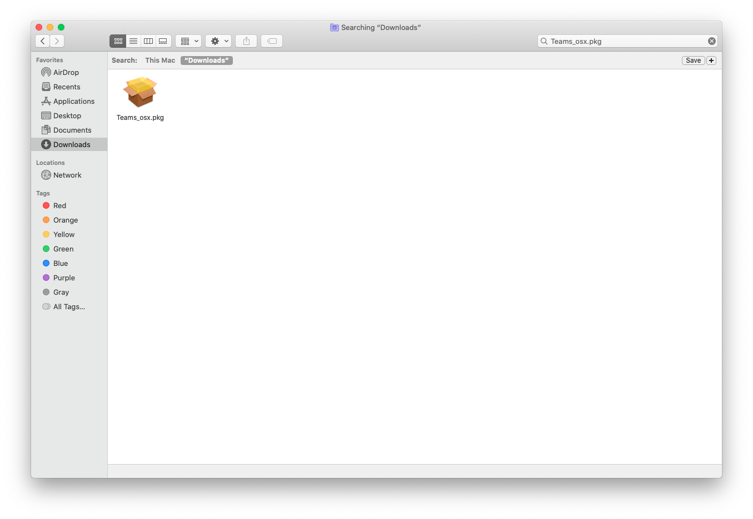
Mac: Find Teams file in Downloads folder. Double-click to launch.

Slide 15
Download Teams on mobile device
Chapter 1
Get started with Teams
Sign into Teams online
Download Teams on desktop
Download Teams on mobile device

Slide 16

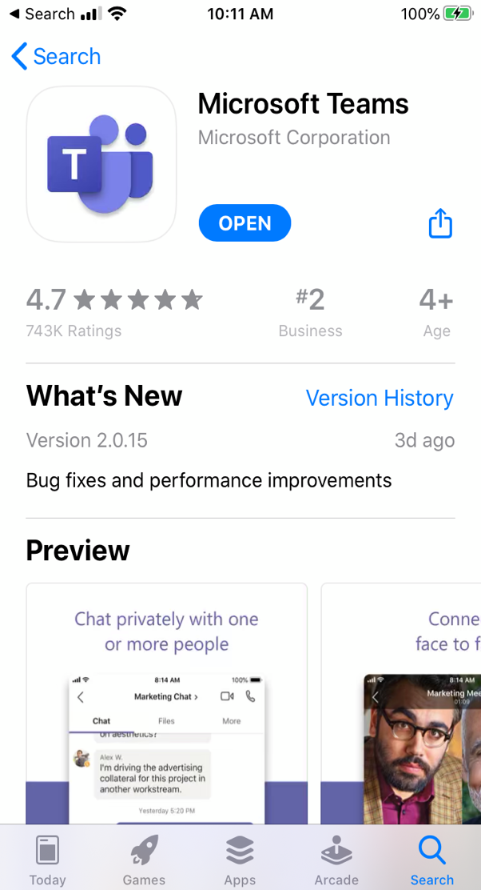
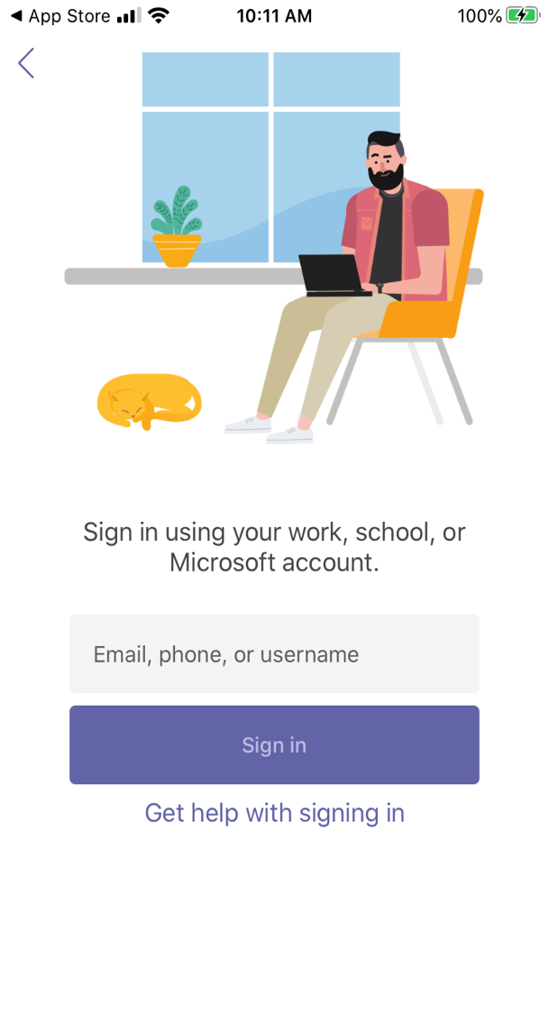
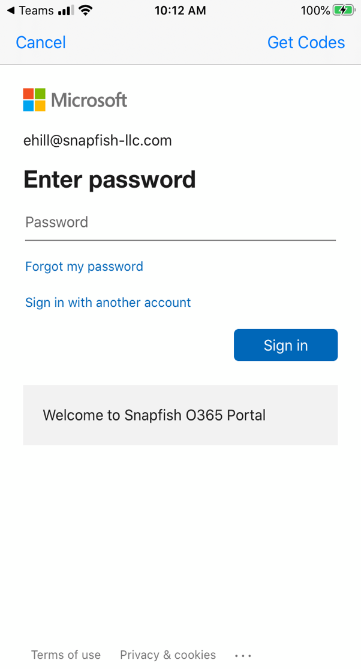


Download Teams on mobile device via the Apple App Store or Google Play.
Enter your student’s school or work account.

Slide 17

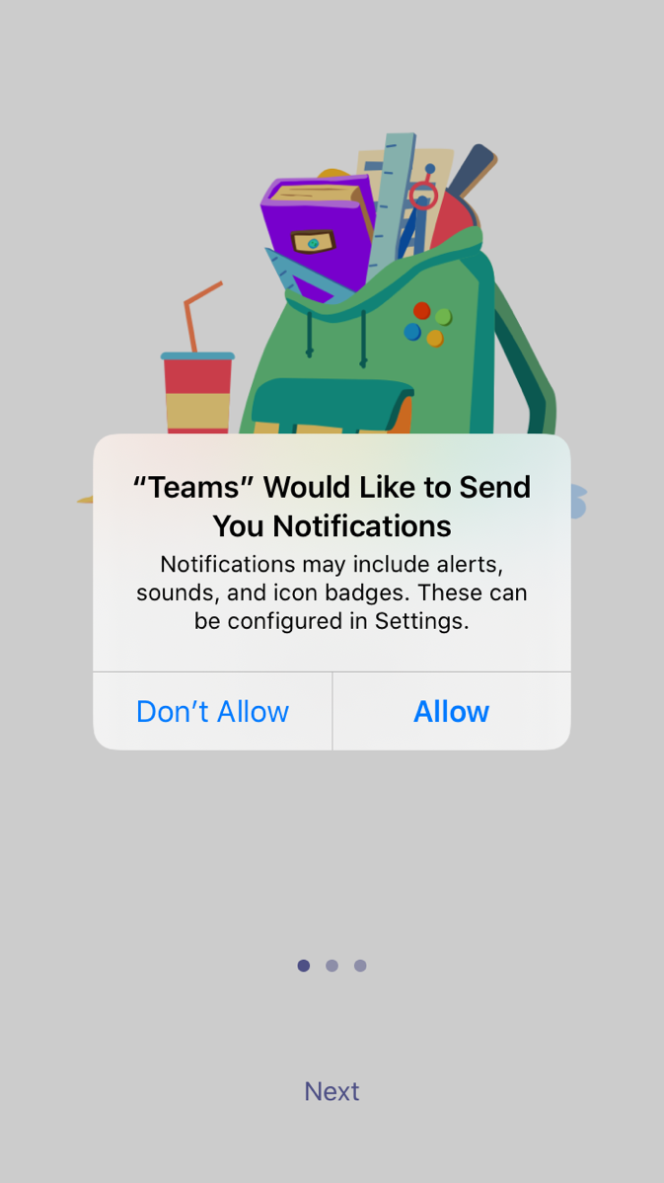
The app will ask you to allow notifications. Click Allow.
Notifications will send an alert to your mobile device when something important is going on in your student’s class, like a class meeting, new assignments, or important announcement.
You can adjust this in Settings.

Slide 18
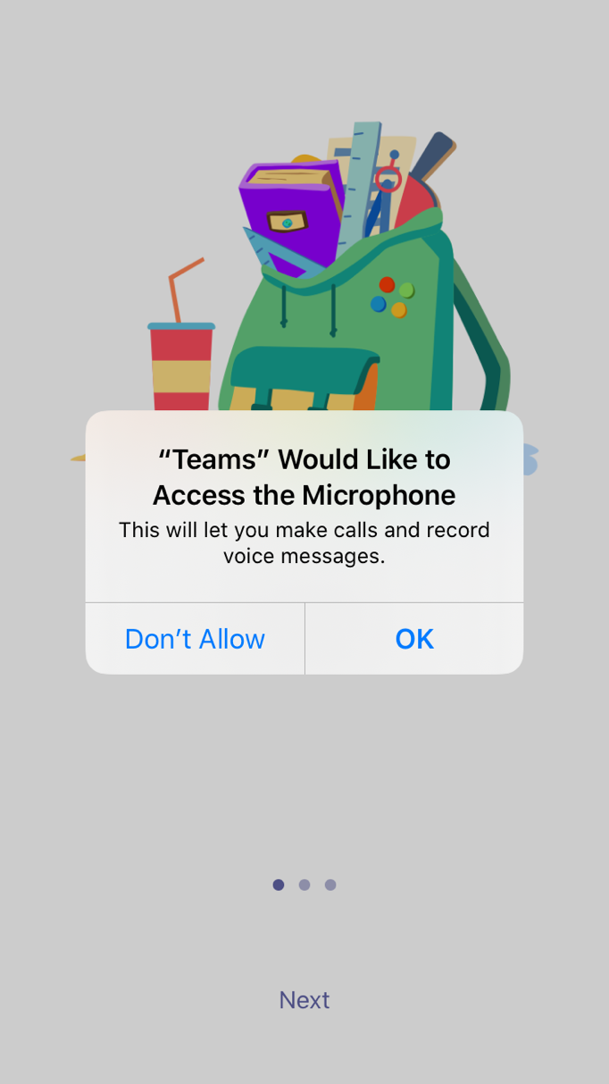
The app will also ask you to allow microphone access. Click OK.
Microphone access may enable your student to participate in class discussions with the mobile device.
You can adjust this in Settings.

Slide 19

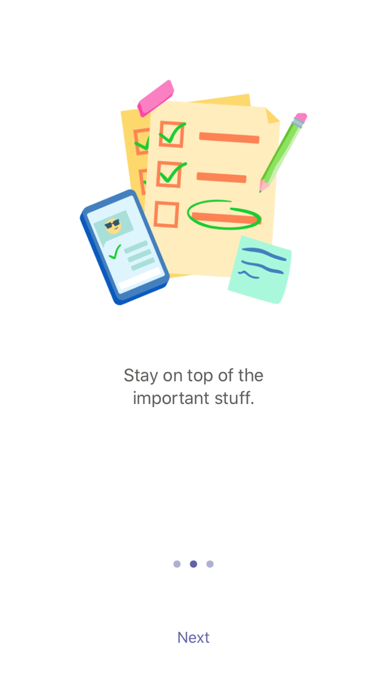
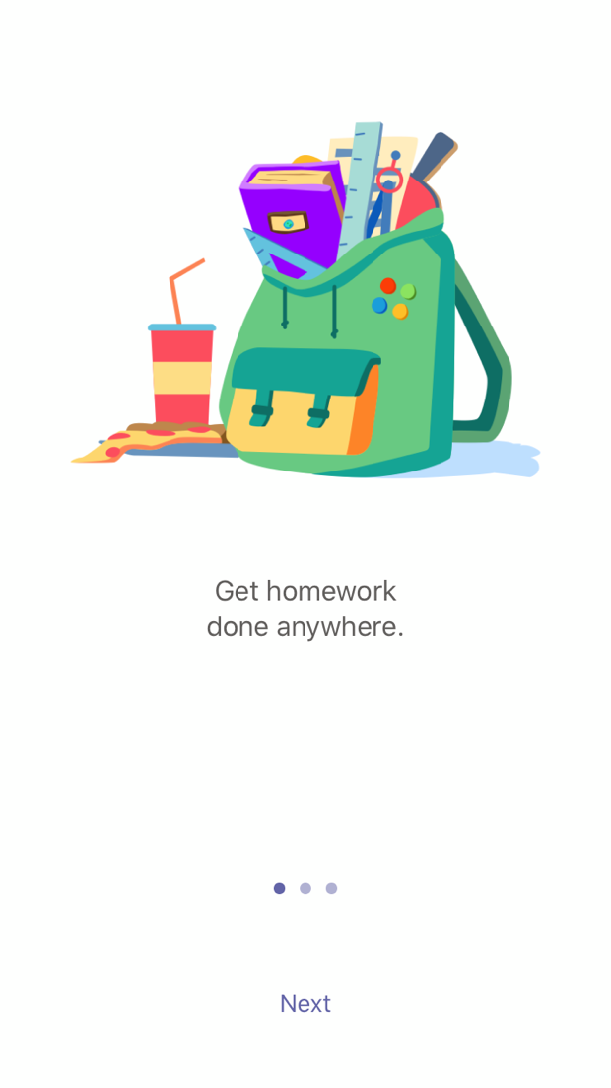
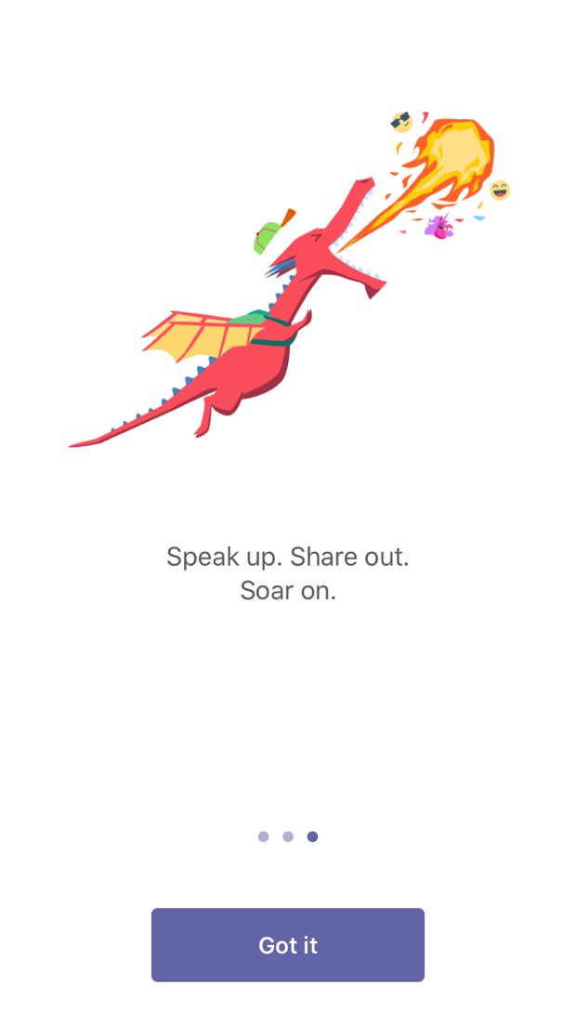
Review welcome screens and click Got it.

Slide 20

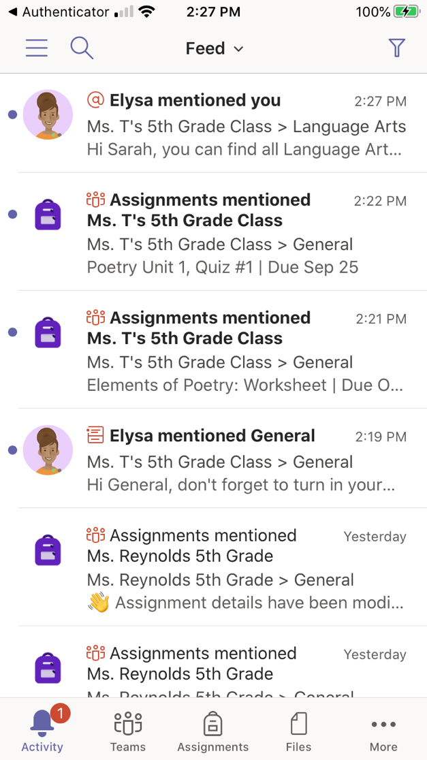
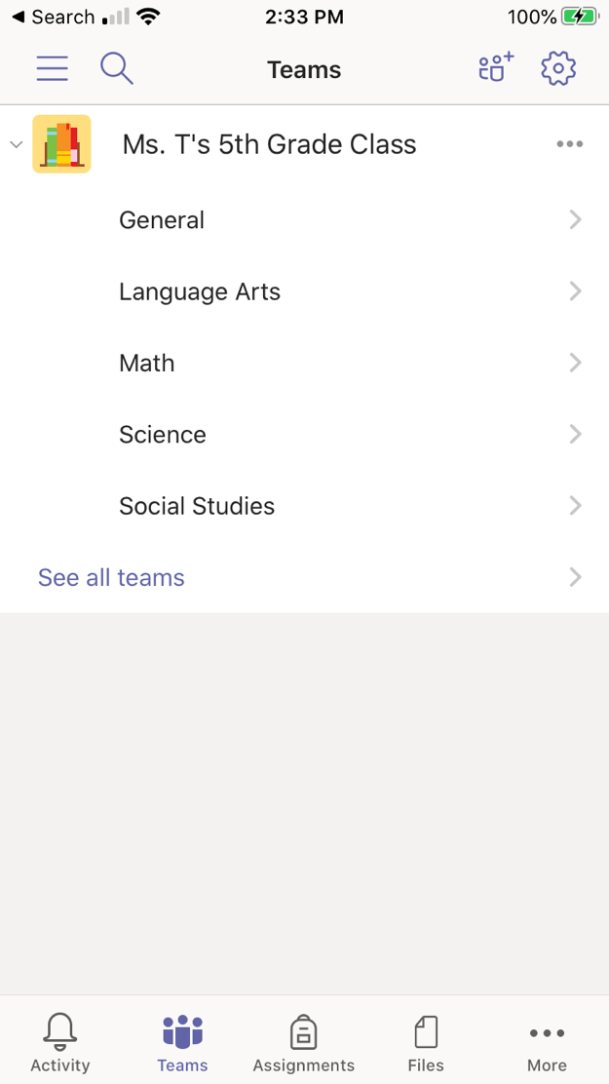

Click on Teams to see your classes.
Now you can view the channels within your class.

Slide 21

Join class team
Chapter 2
How to help your student use Teams
Join a class team
View and turn in assignments
Attend a virtual class
Find grades
Chat with teachers and classmates

Slide 22
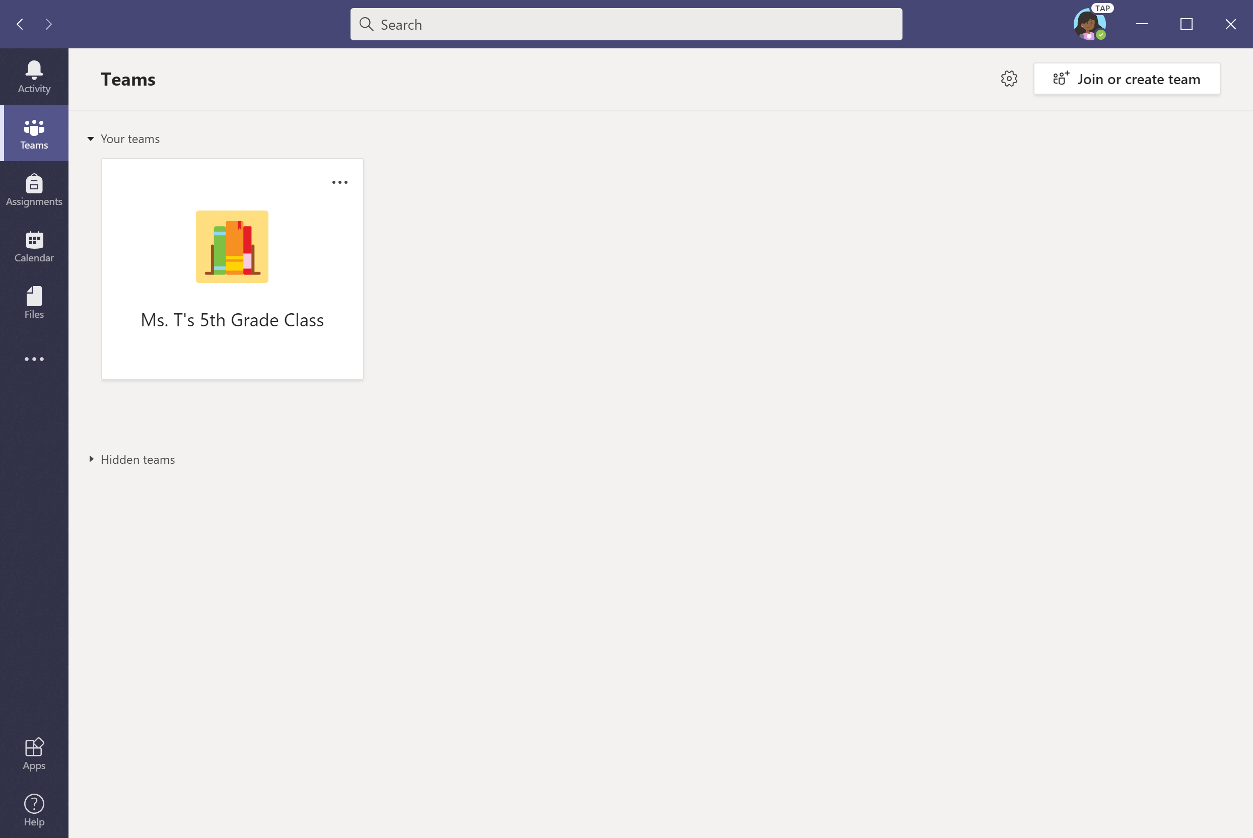

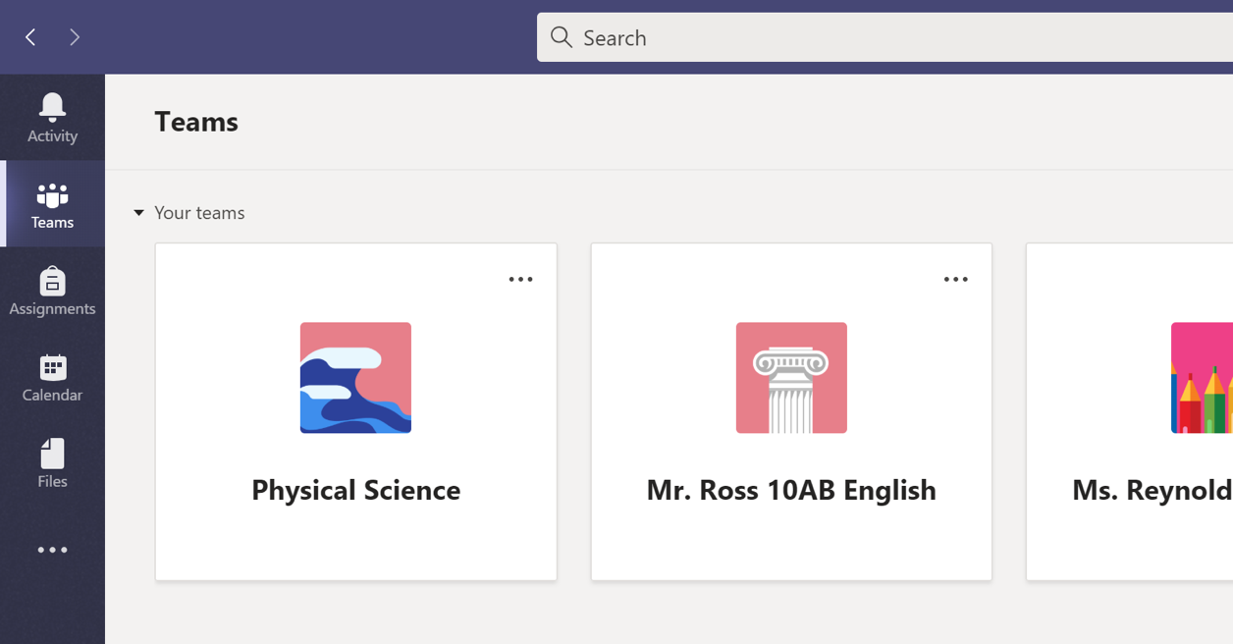
When Teams opens, click on your student’s class tile.
Upper grades may see more than one class. Click on one class to get started.

Slide 23
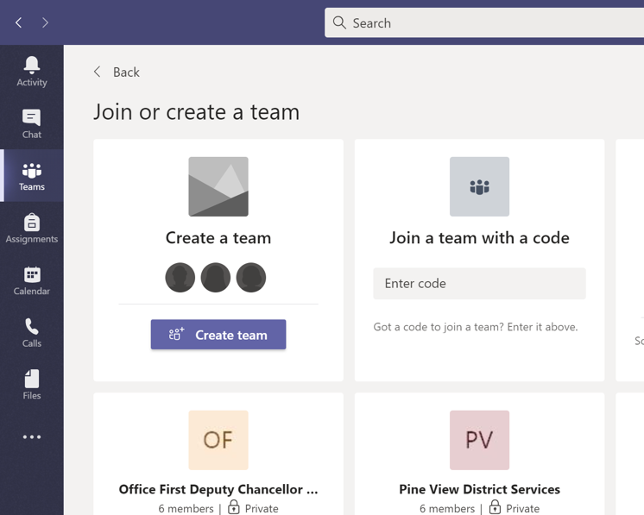

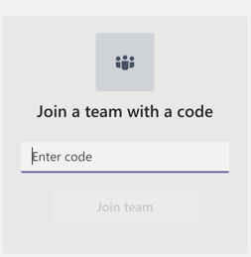
Don’t see any classes? The teacher may have invited your student to join the class team with a join code. Click Join Team.
Enter code to join your team.

Slide 24
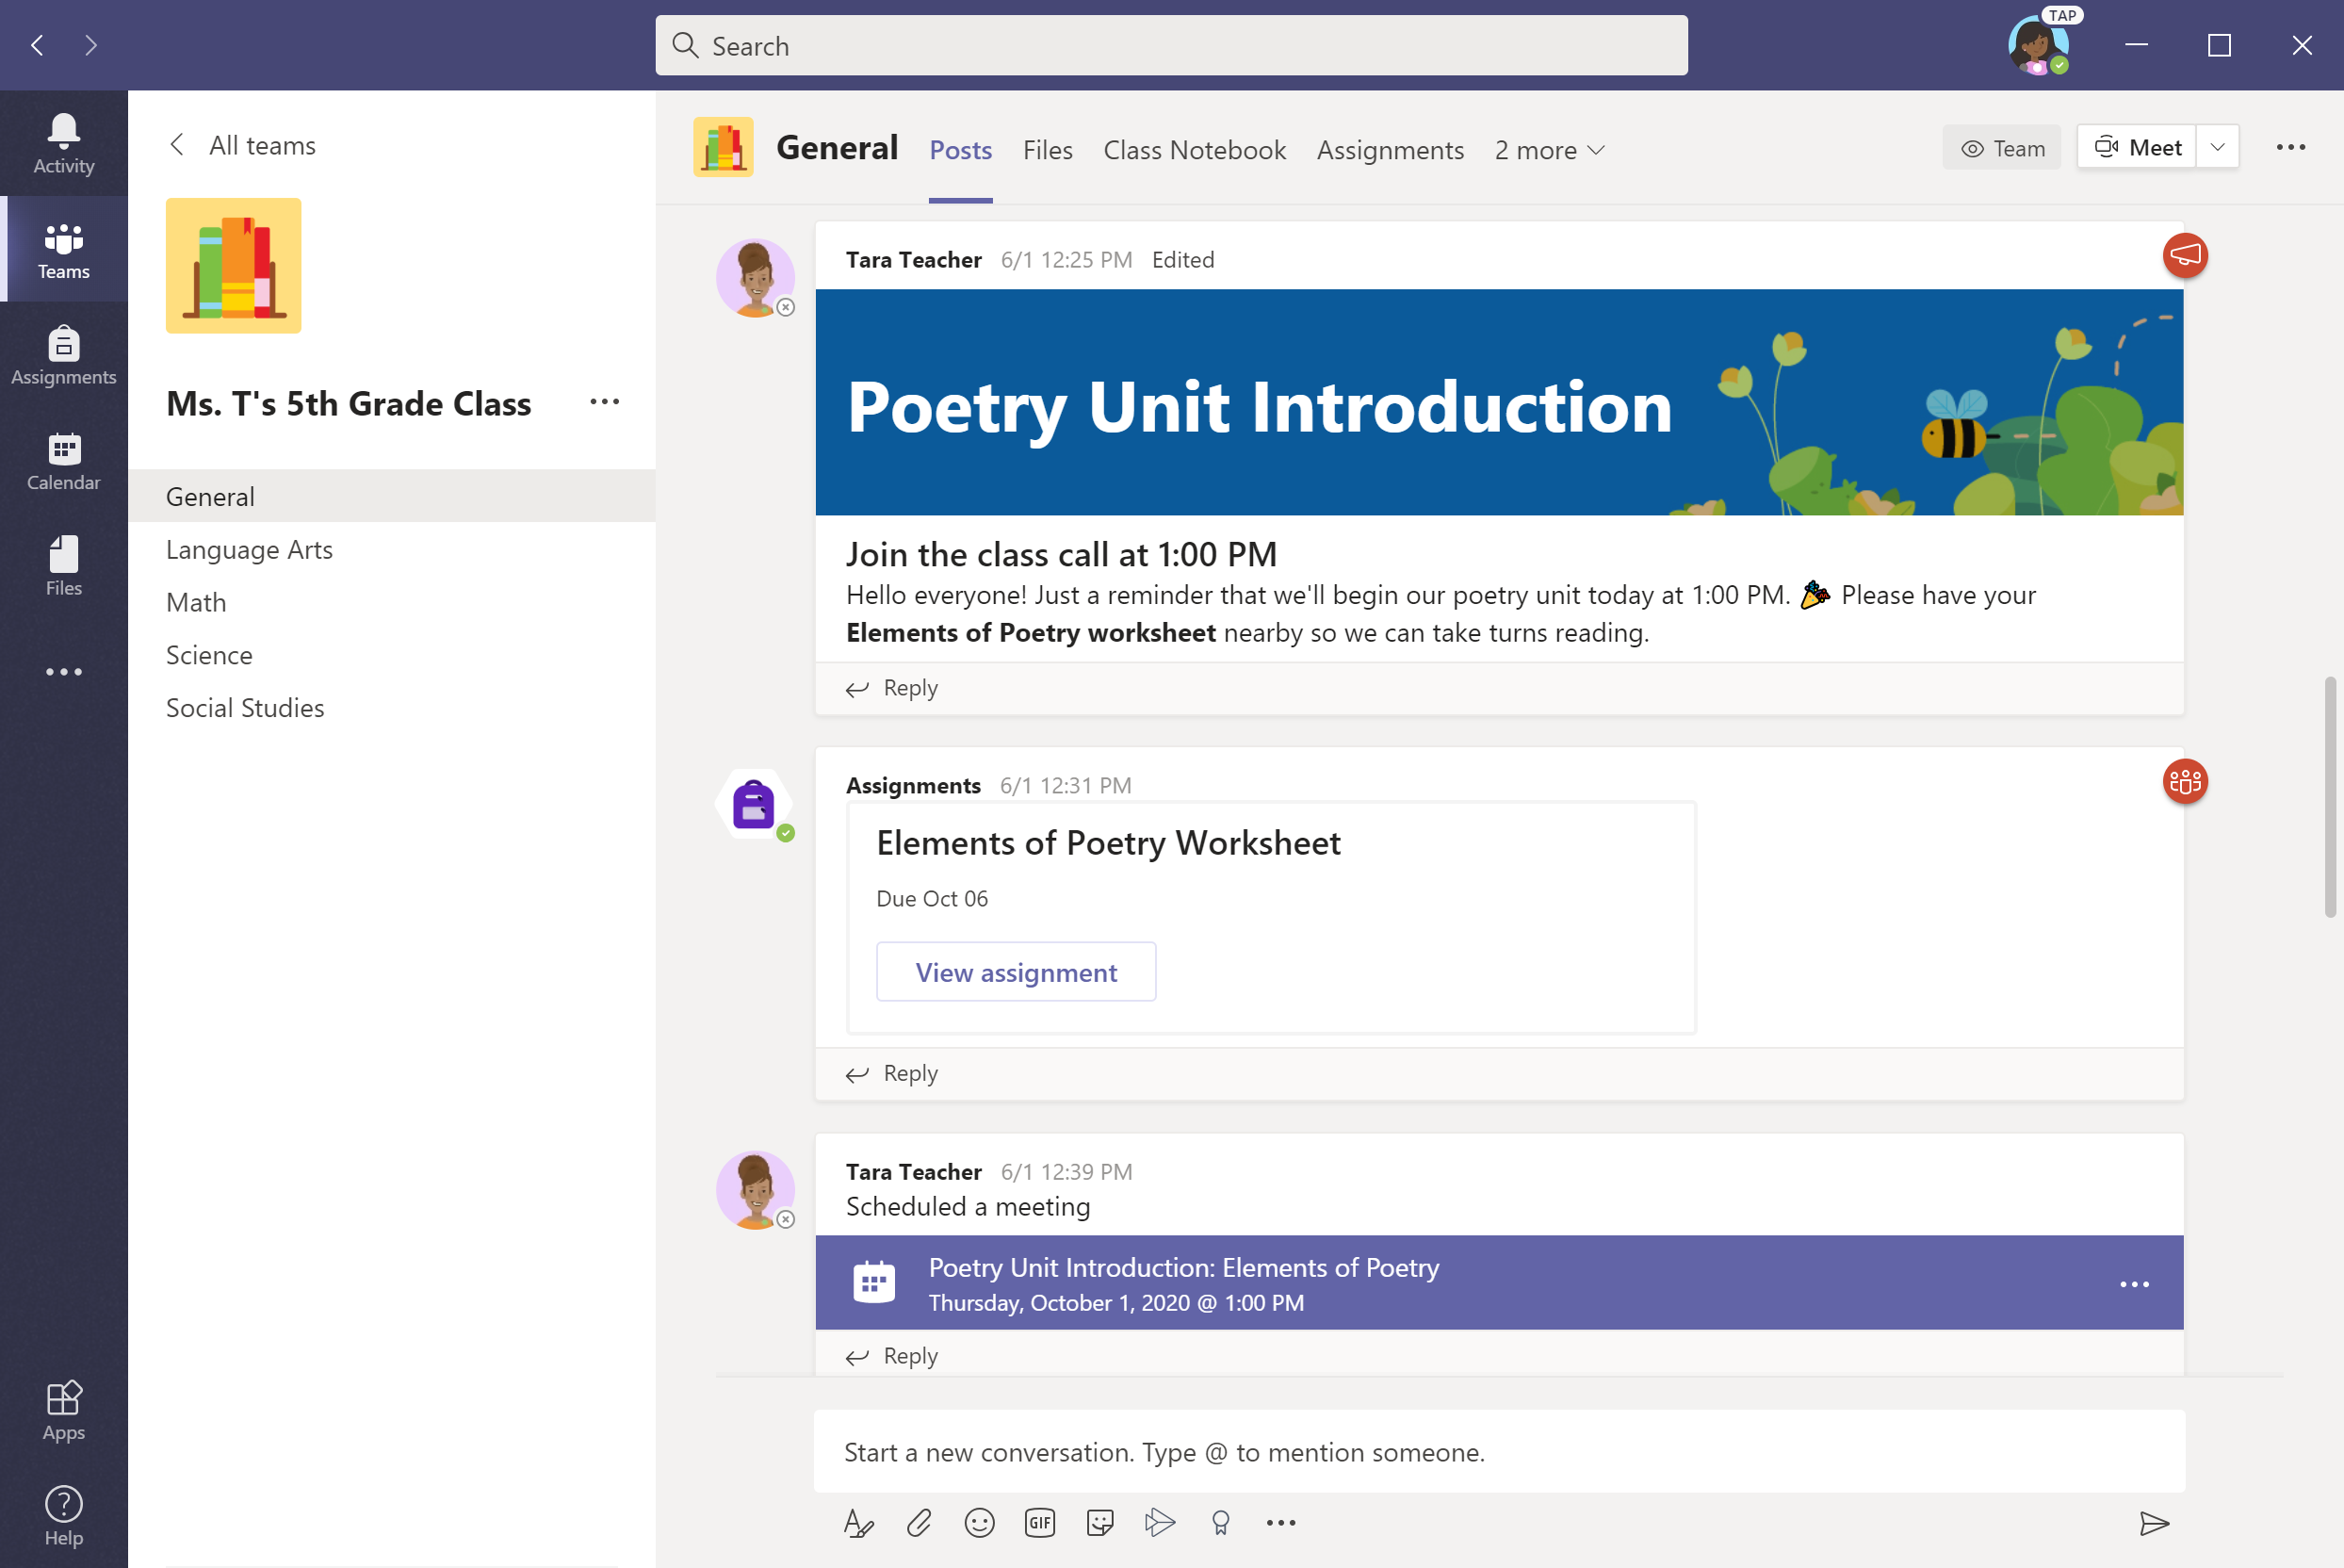
After selecting your student’s class, you’ll see channels that the teacher has created. These might be subjects, units, or other labels.

Slide 25
View and turn in assignments
Chapter 2
How to help your student use Teams
Join a class team
View and turn in assignments
Attend a virtual class
Find grades
Chat with teachers and classmates

Slide 26
Assignments can be viewed and submitted
many ways on Teams. Here are some common options.

Slide 27
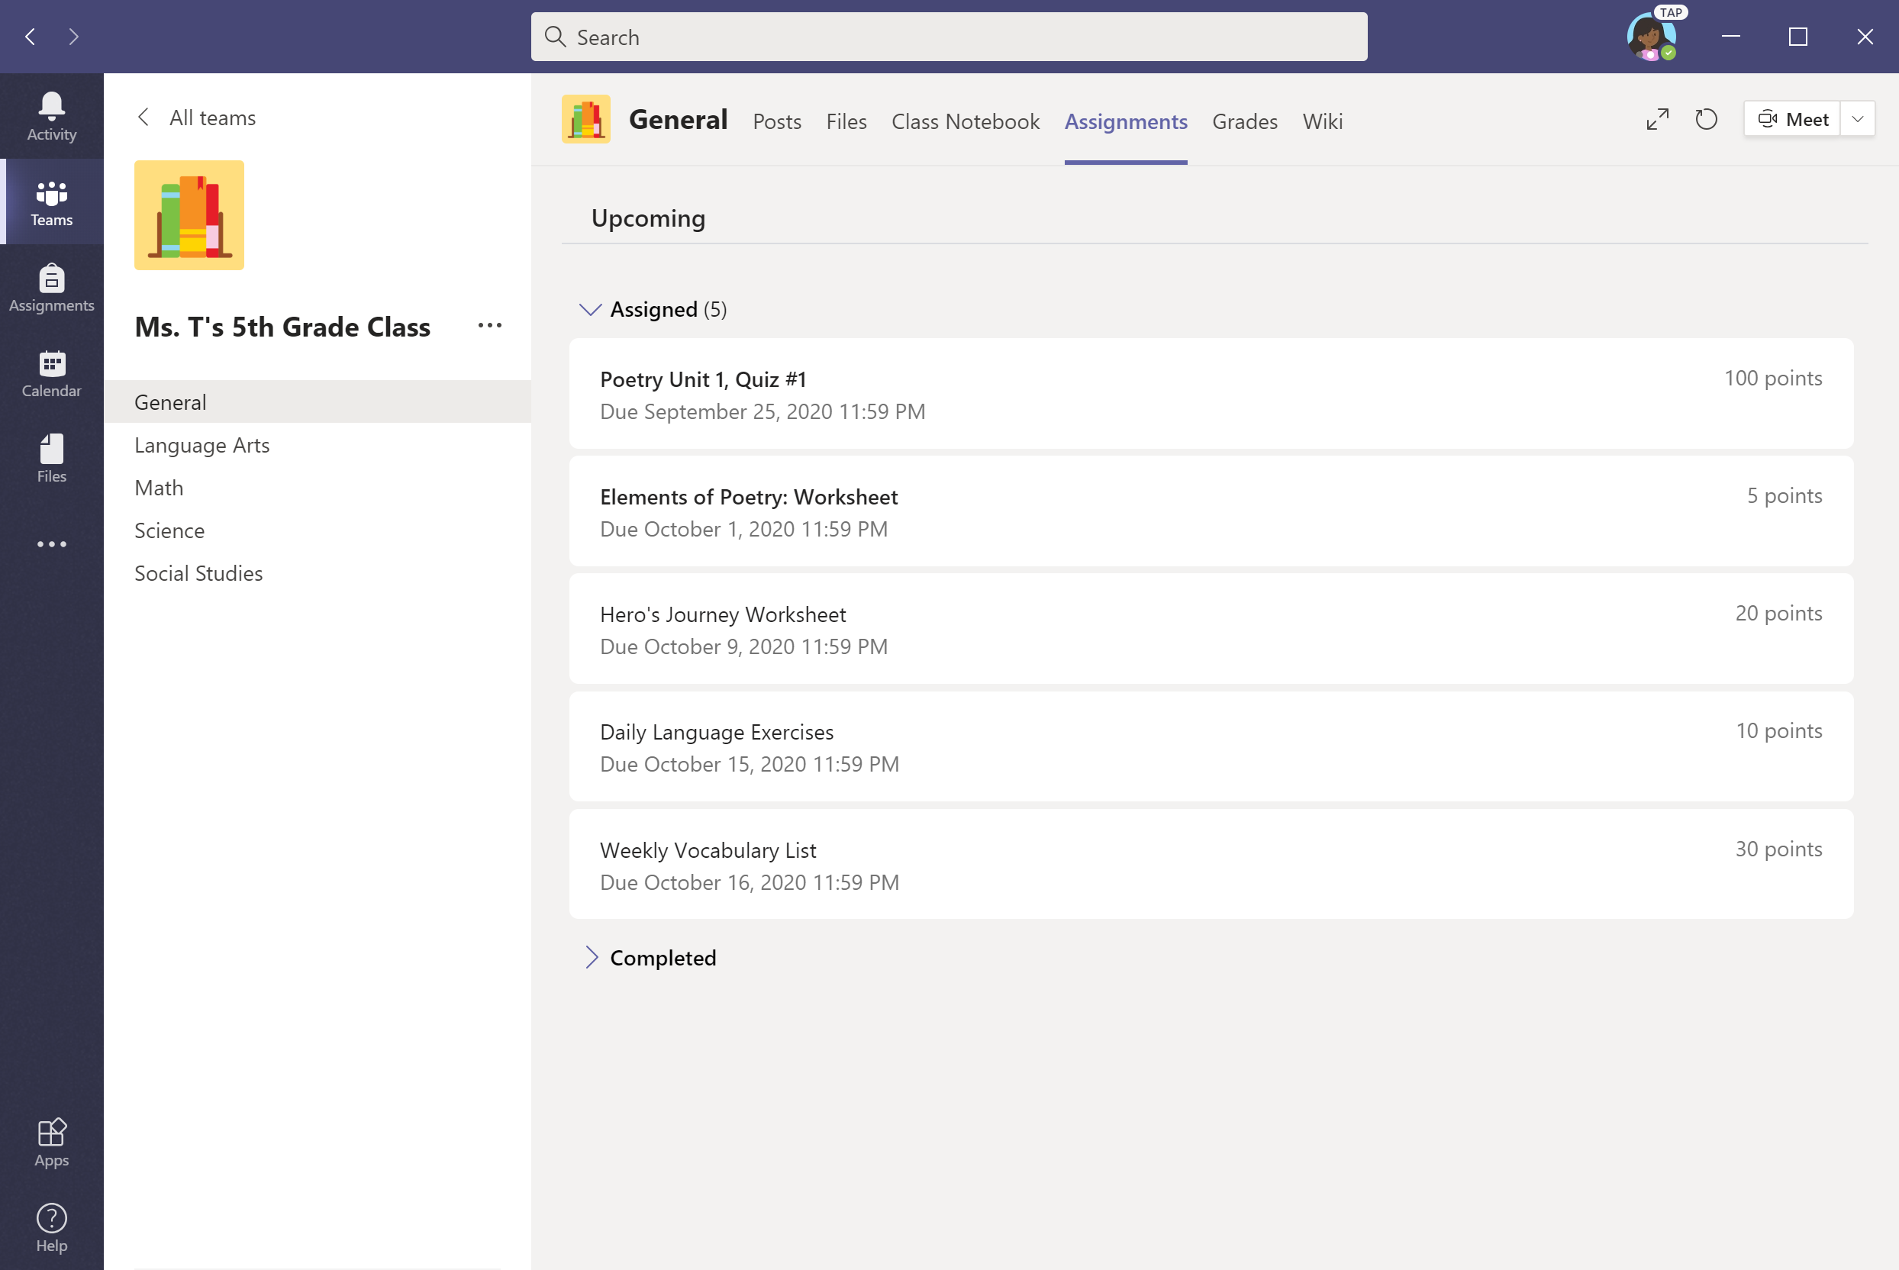
Option #1: To view all assignments, go to the General channel & select the Assignments tab.

Slide 28
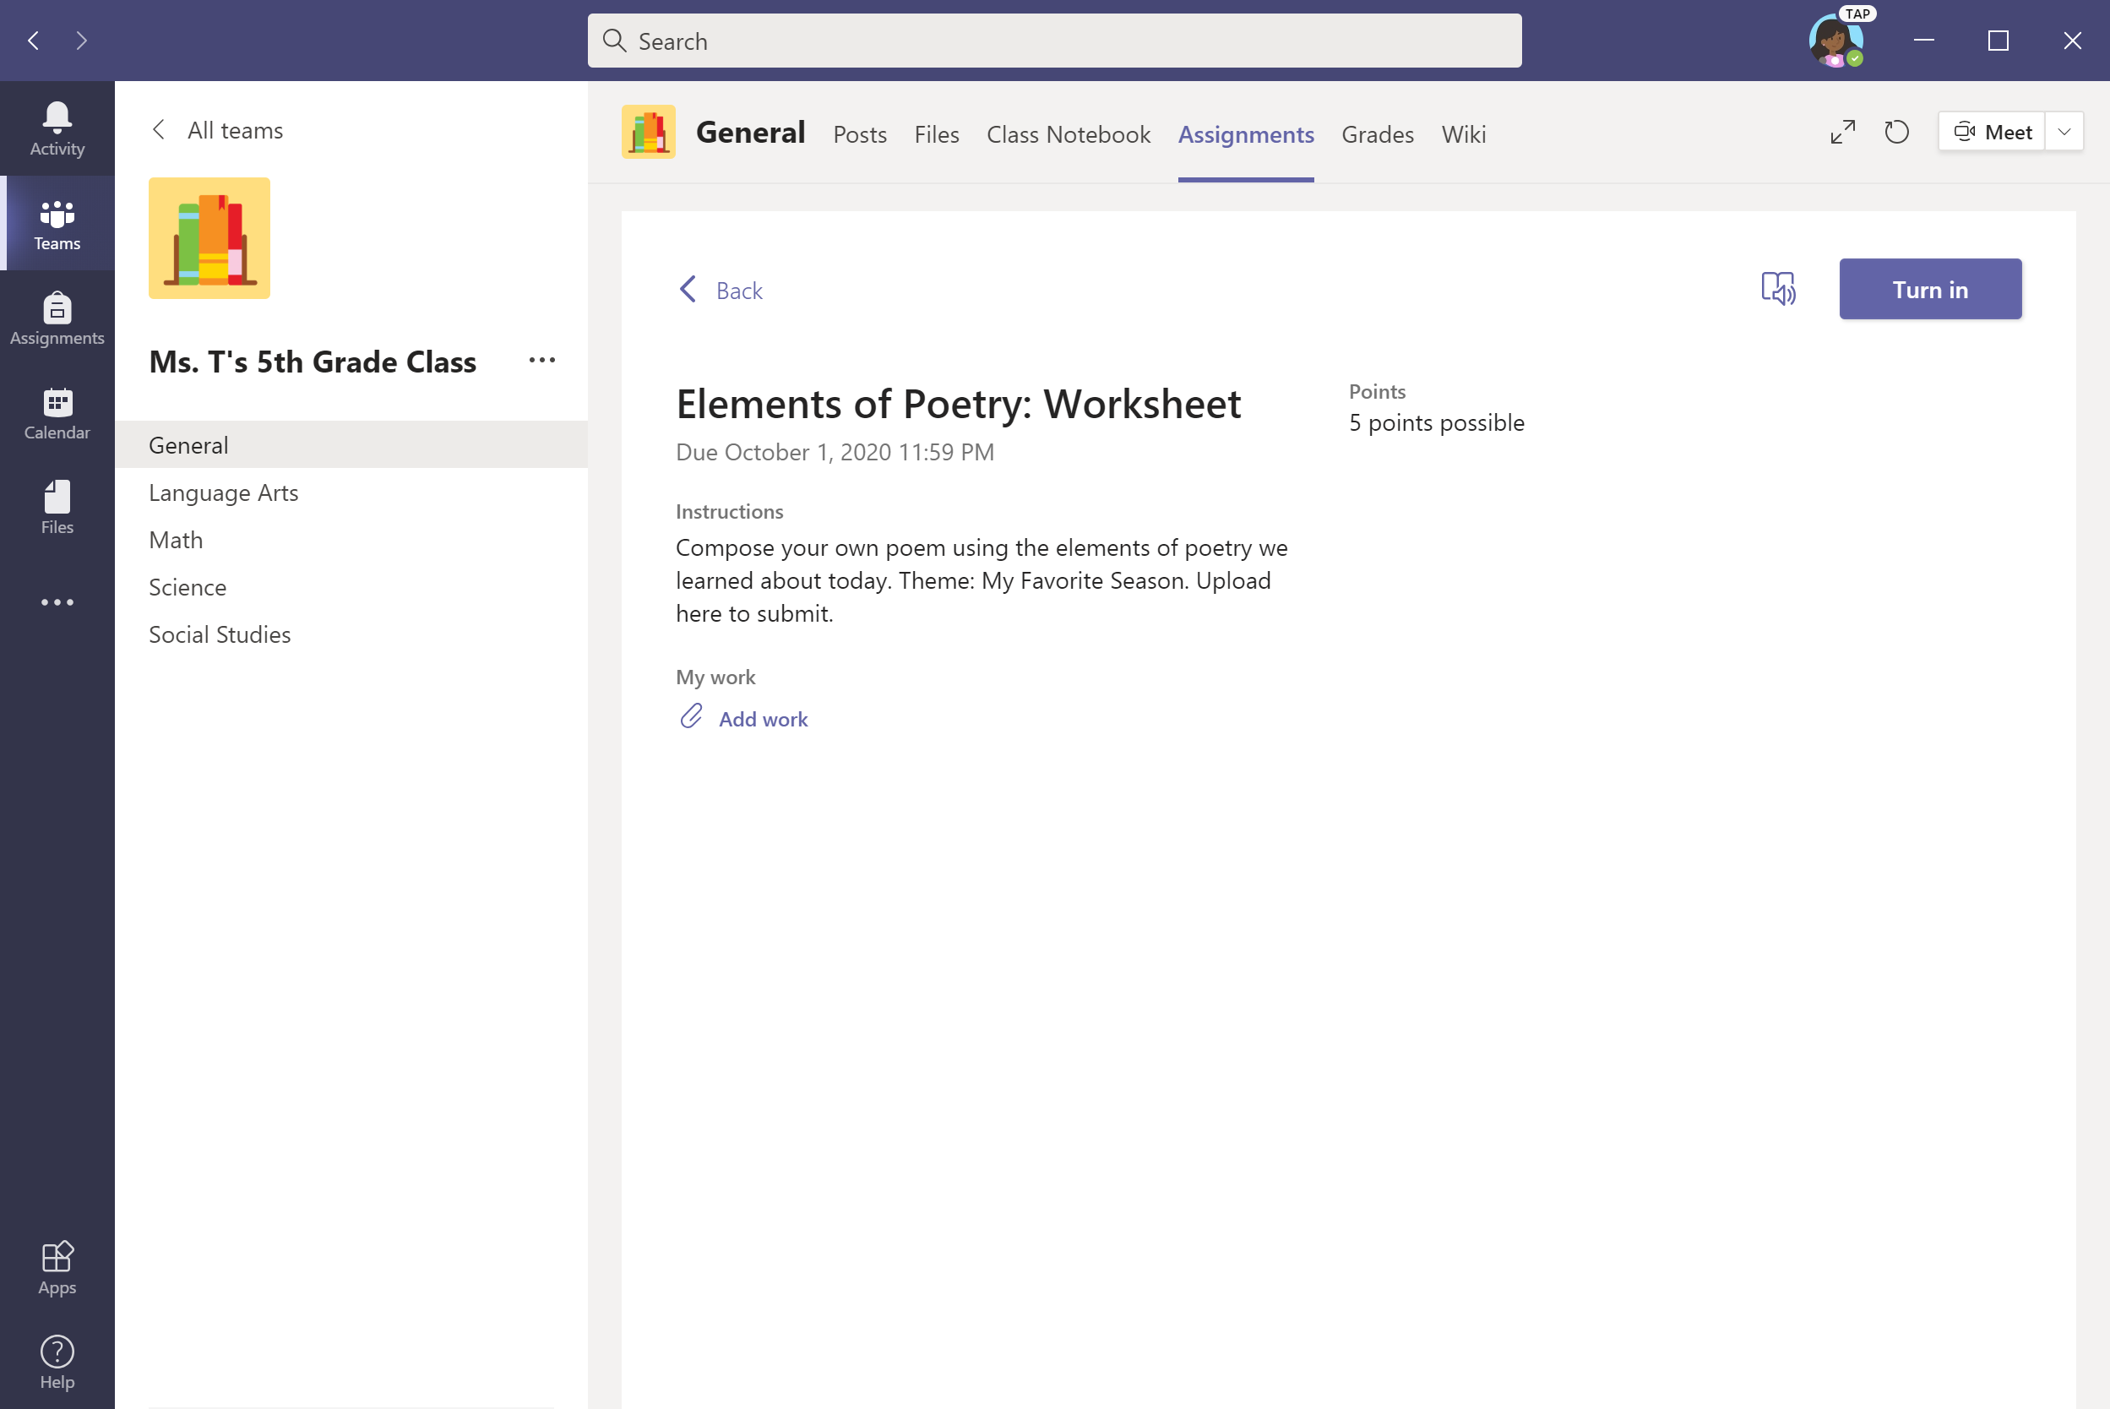
To upload work, select + Add work.

Slide 29
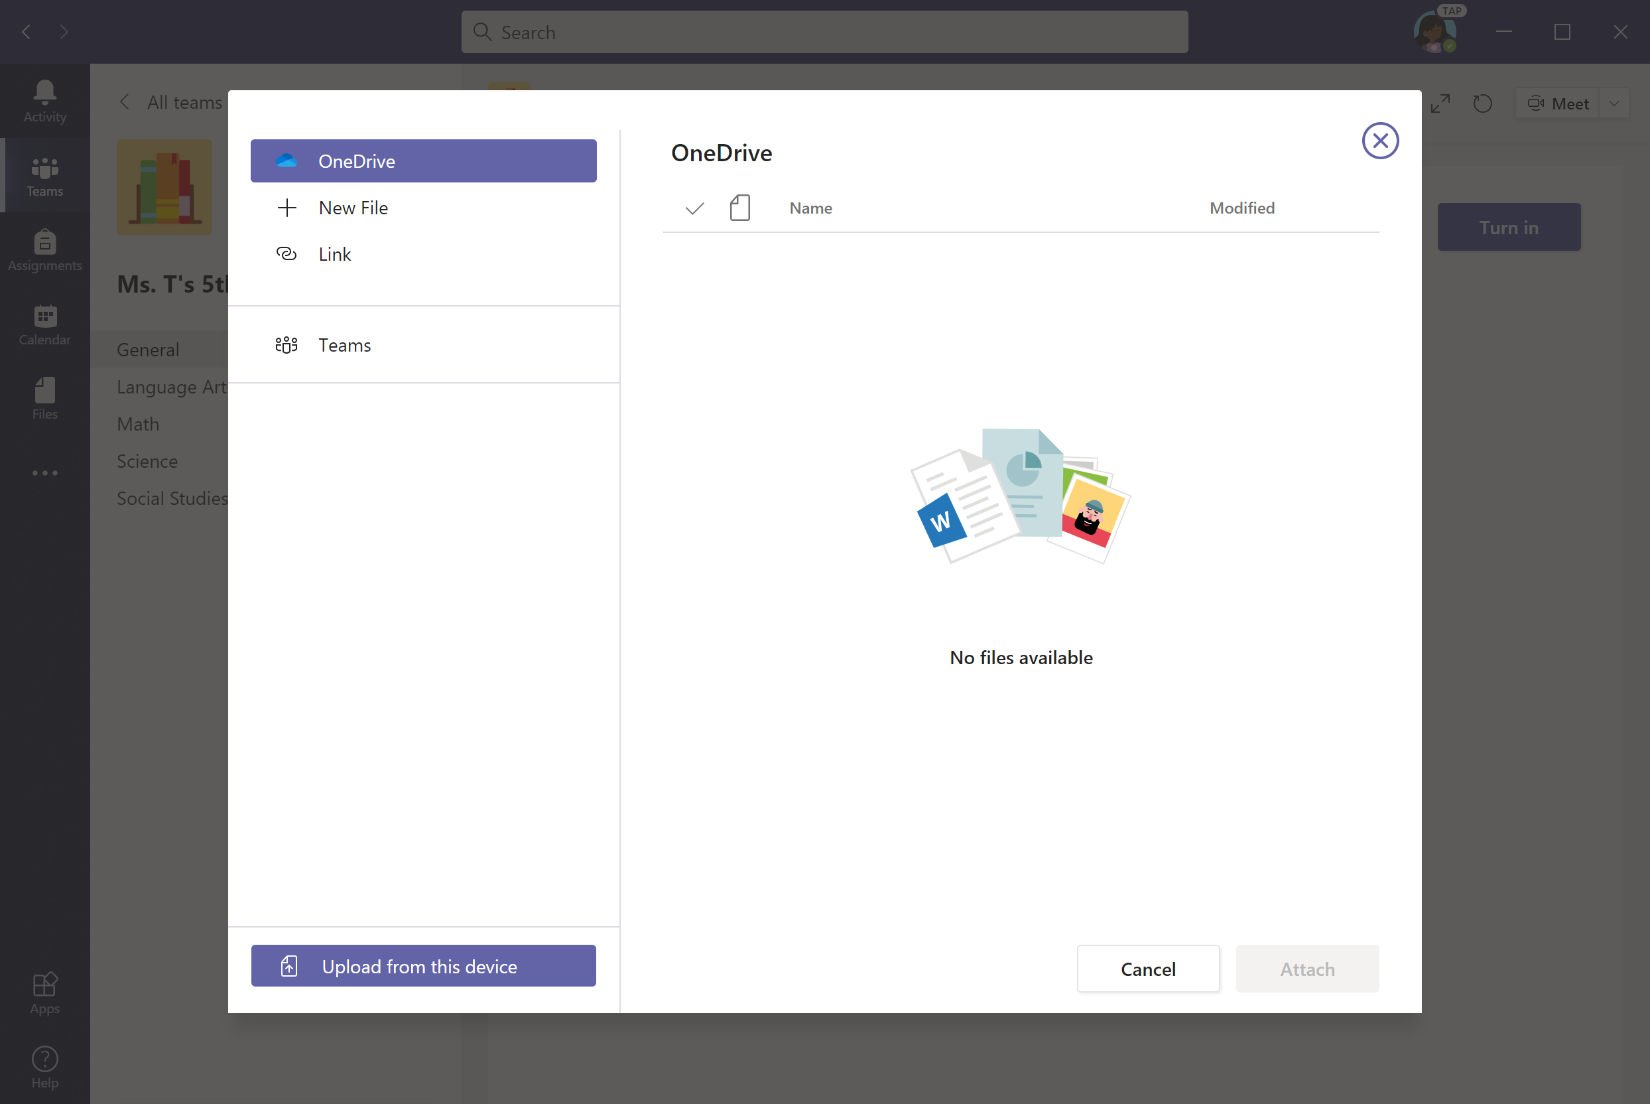
Upload file from your device, OneDrive, Teams, or a link. Let’s upload from device for this example.

Slide 30
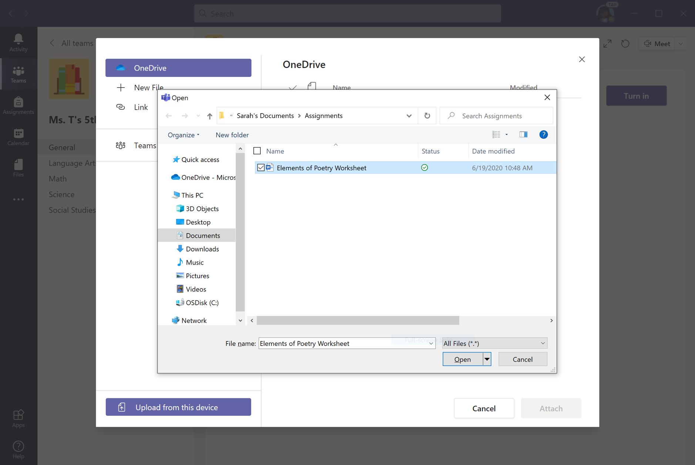
Select file and click Open.

Slide 31
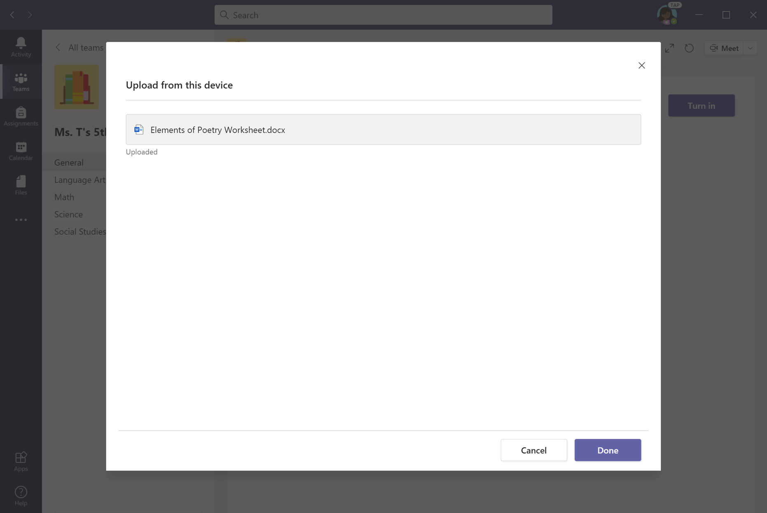
Click Done—but you’re not done yet.

Slide 32
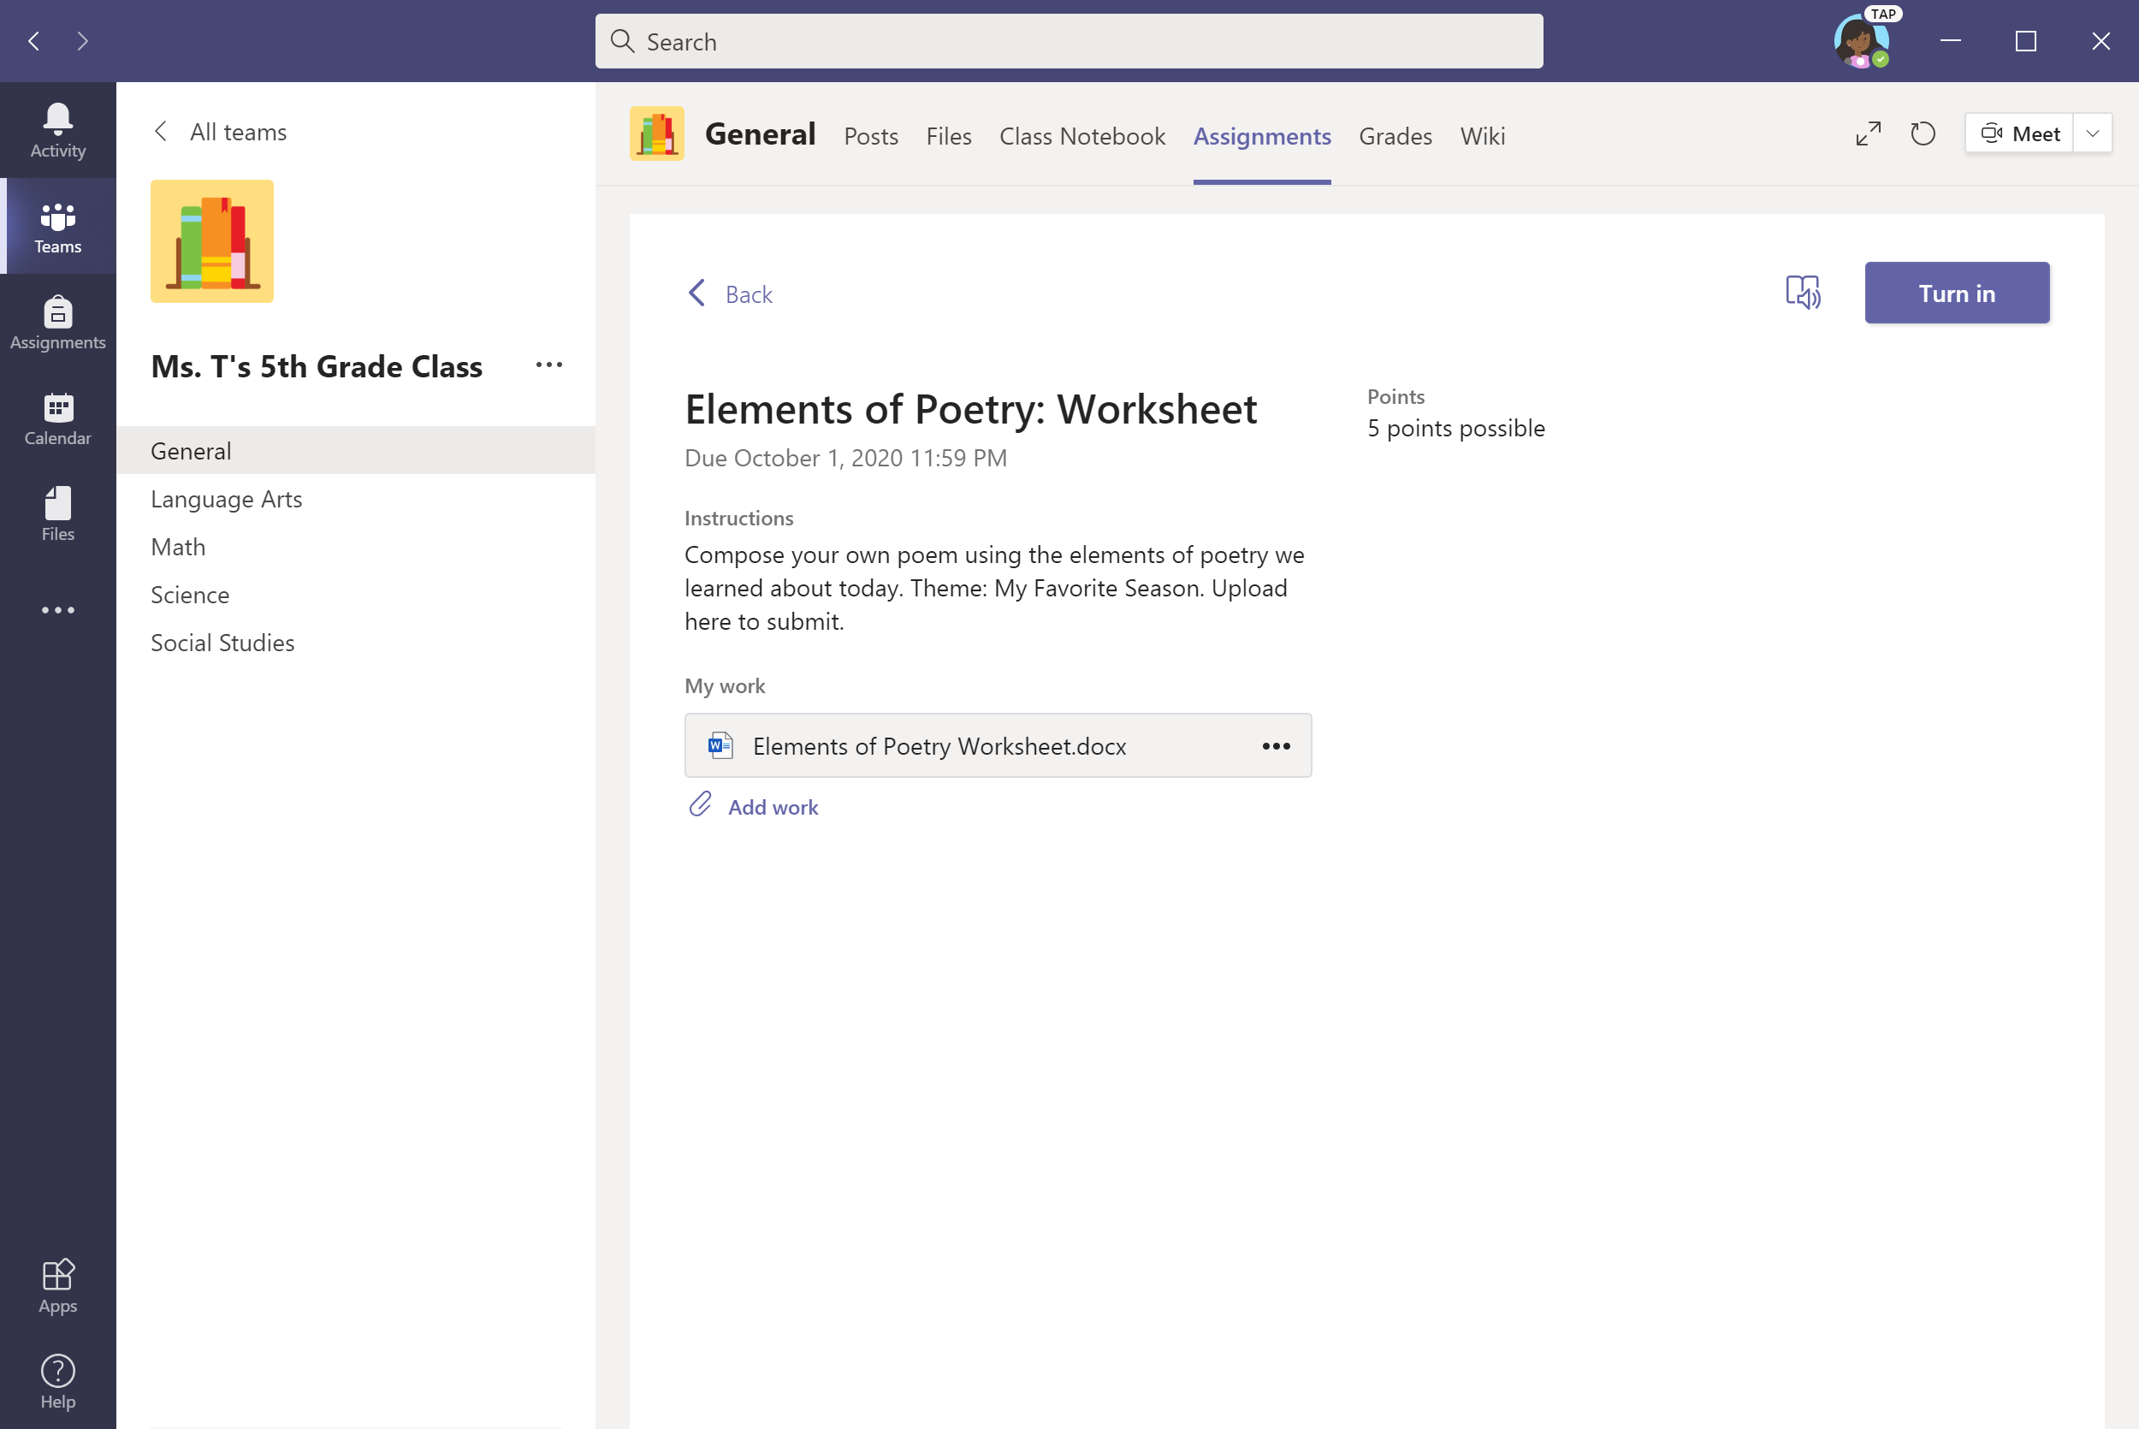
Click Turn in to submit assignment.

Slide 33

An animation will signal that the assignment has been submitted.

Slide 34
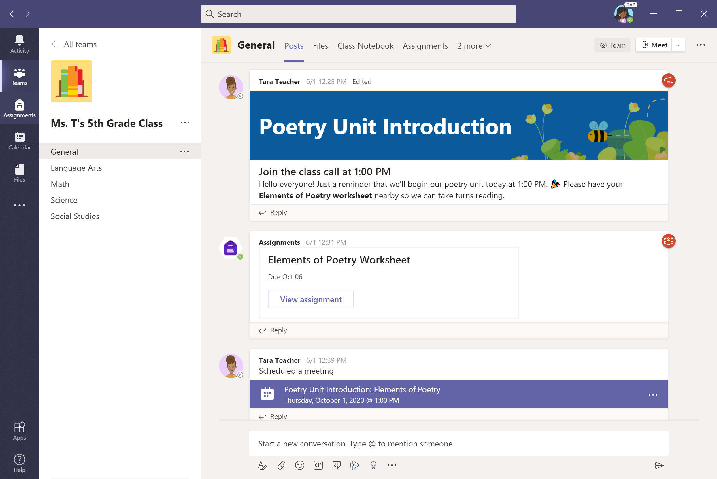
Alternate option for submitting assignments: Select Assignments in the left panel.
Notes:
Box focus in on ‘view assignment’

Slide 35
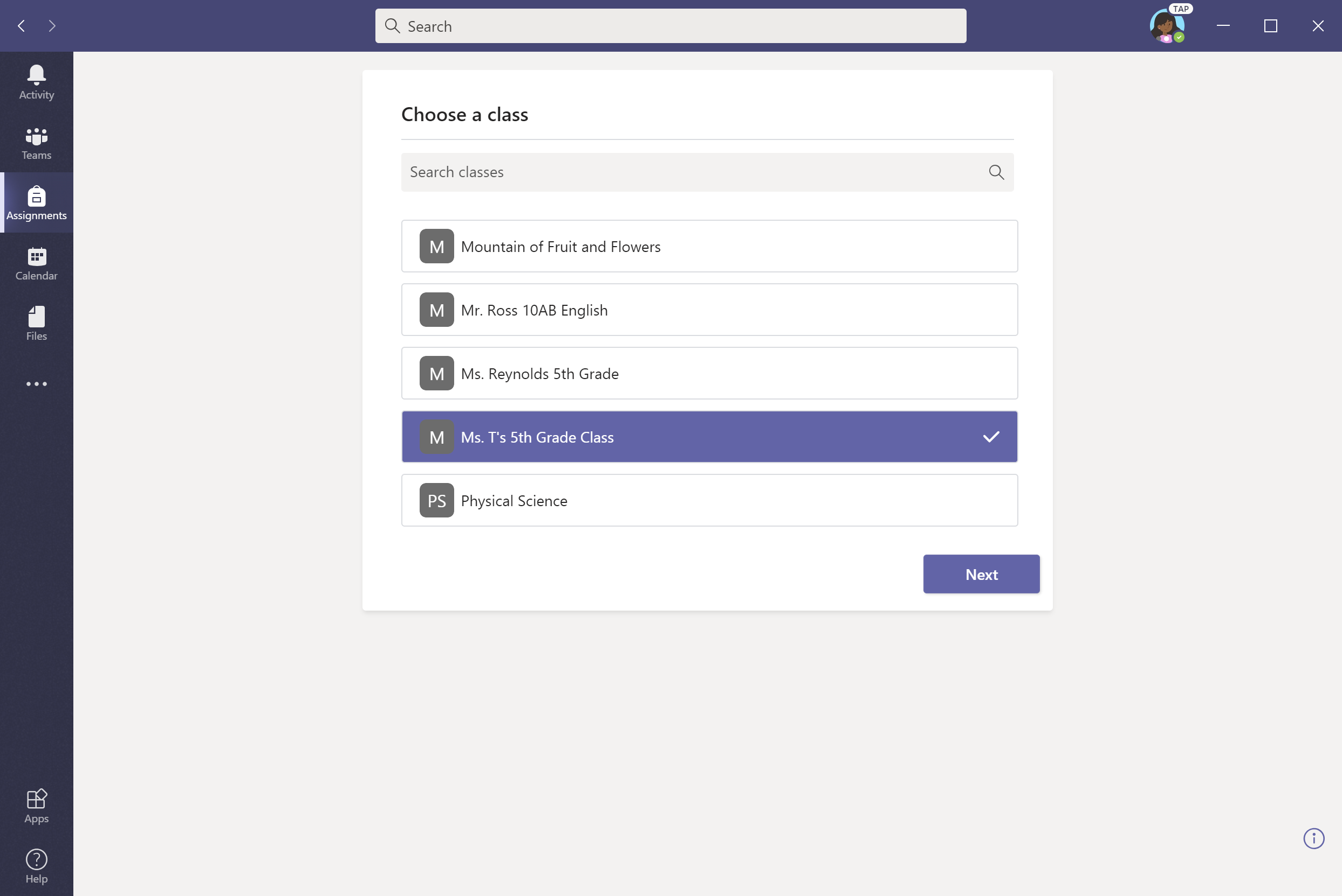
Select a class.

Slide 36
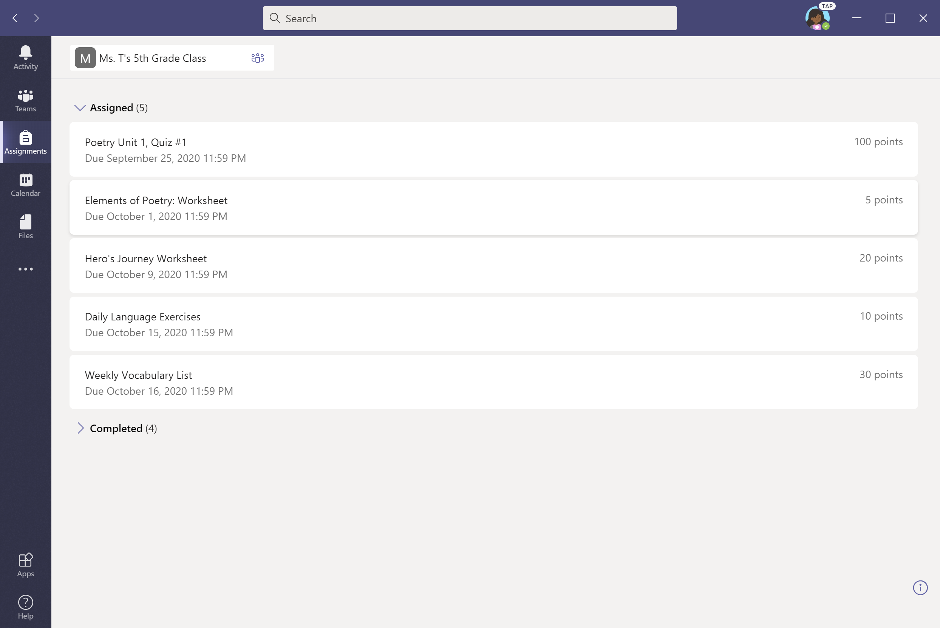
Select assignment.

Slide 37
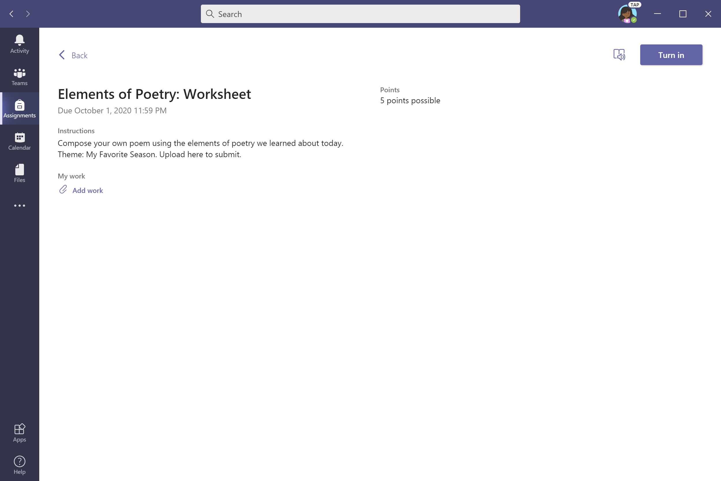
To upload work, select + Add work.

Slide 38
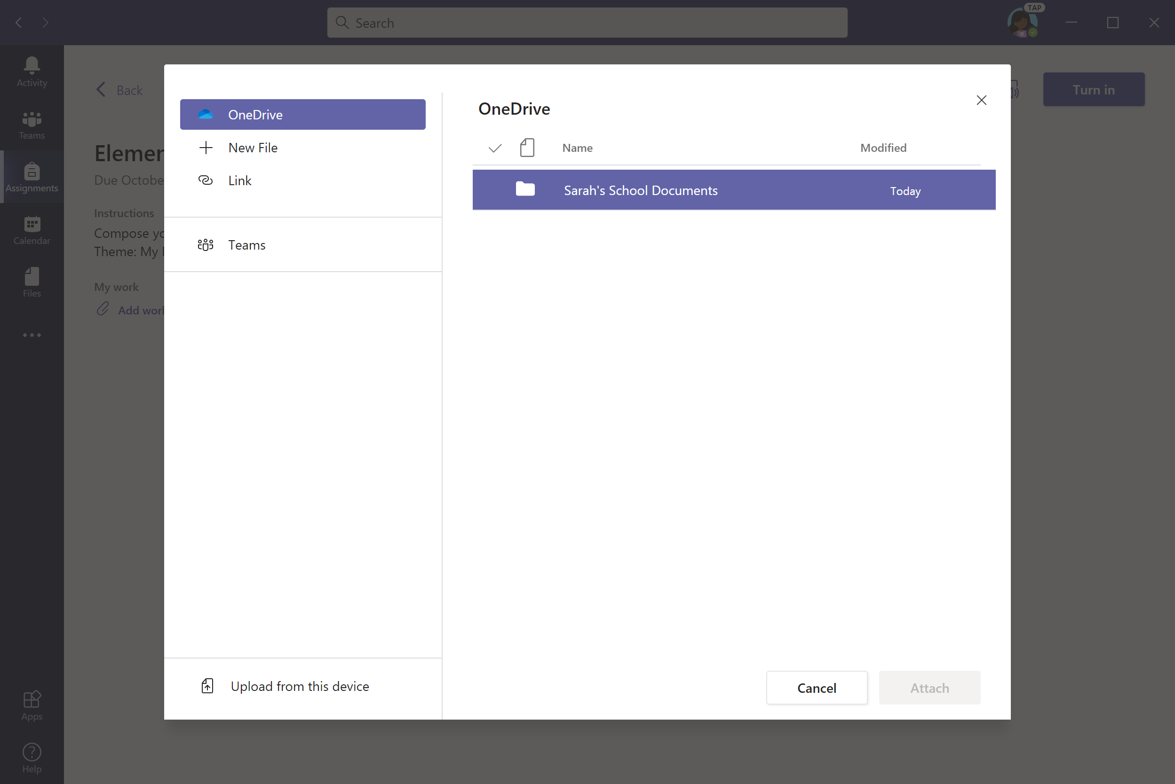
Let’s upload from OneDrive for this example. Click desired folder to find assignment.

Slide 39
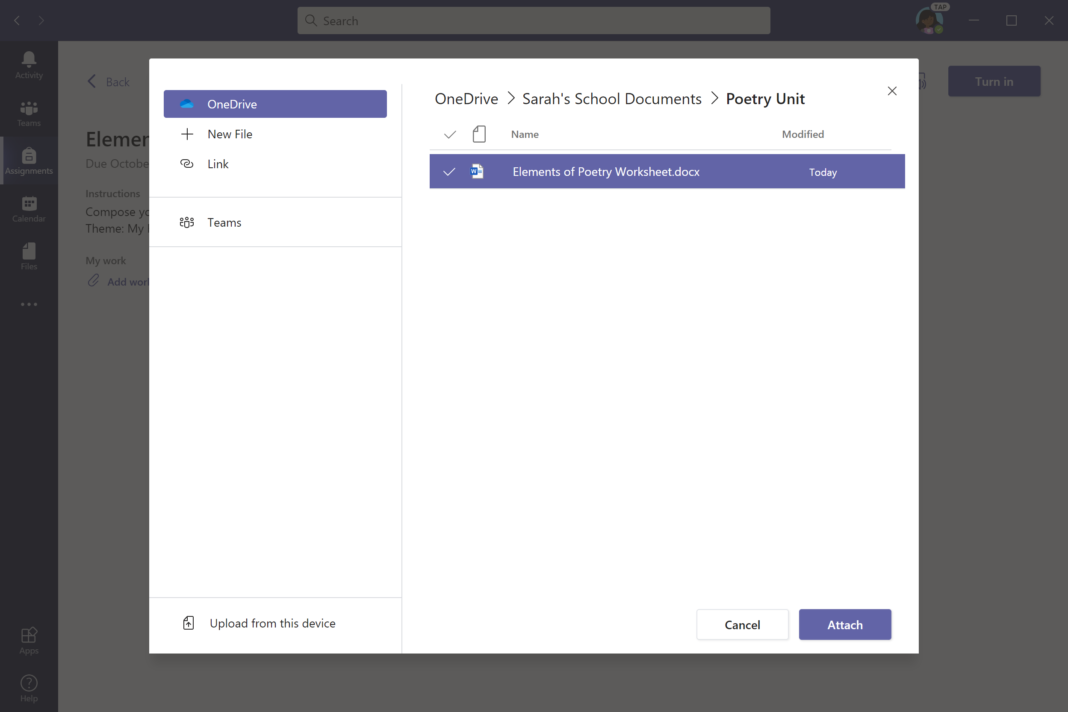
Select a file and click Attach.

Slide 40
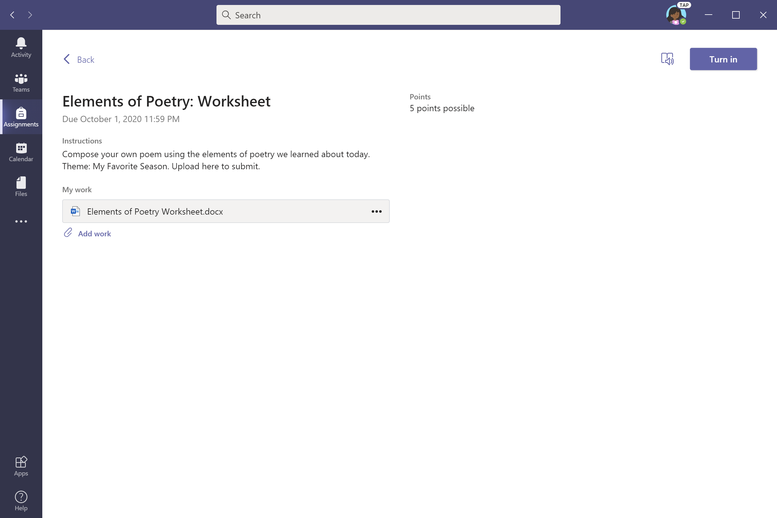
Click Turn in to submit assignment.

Slide 41

An animation will signal that the assignment as been turned in.

Slide 42
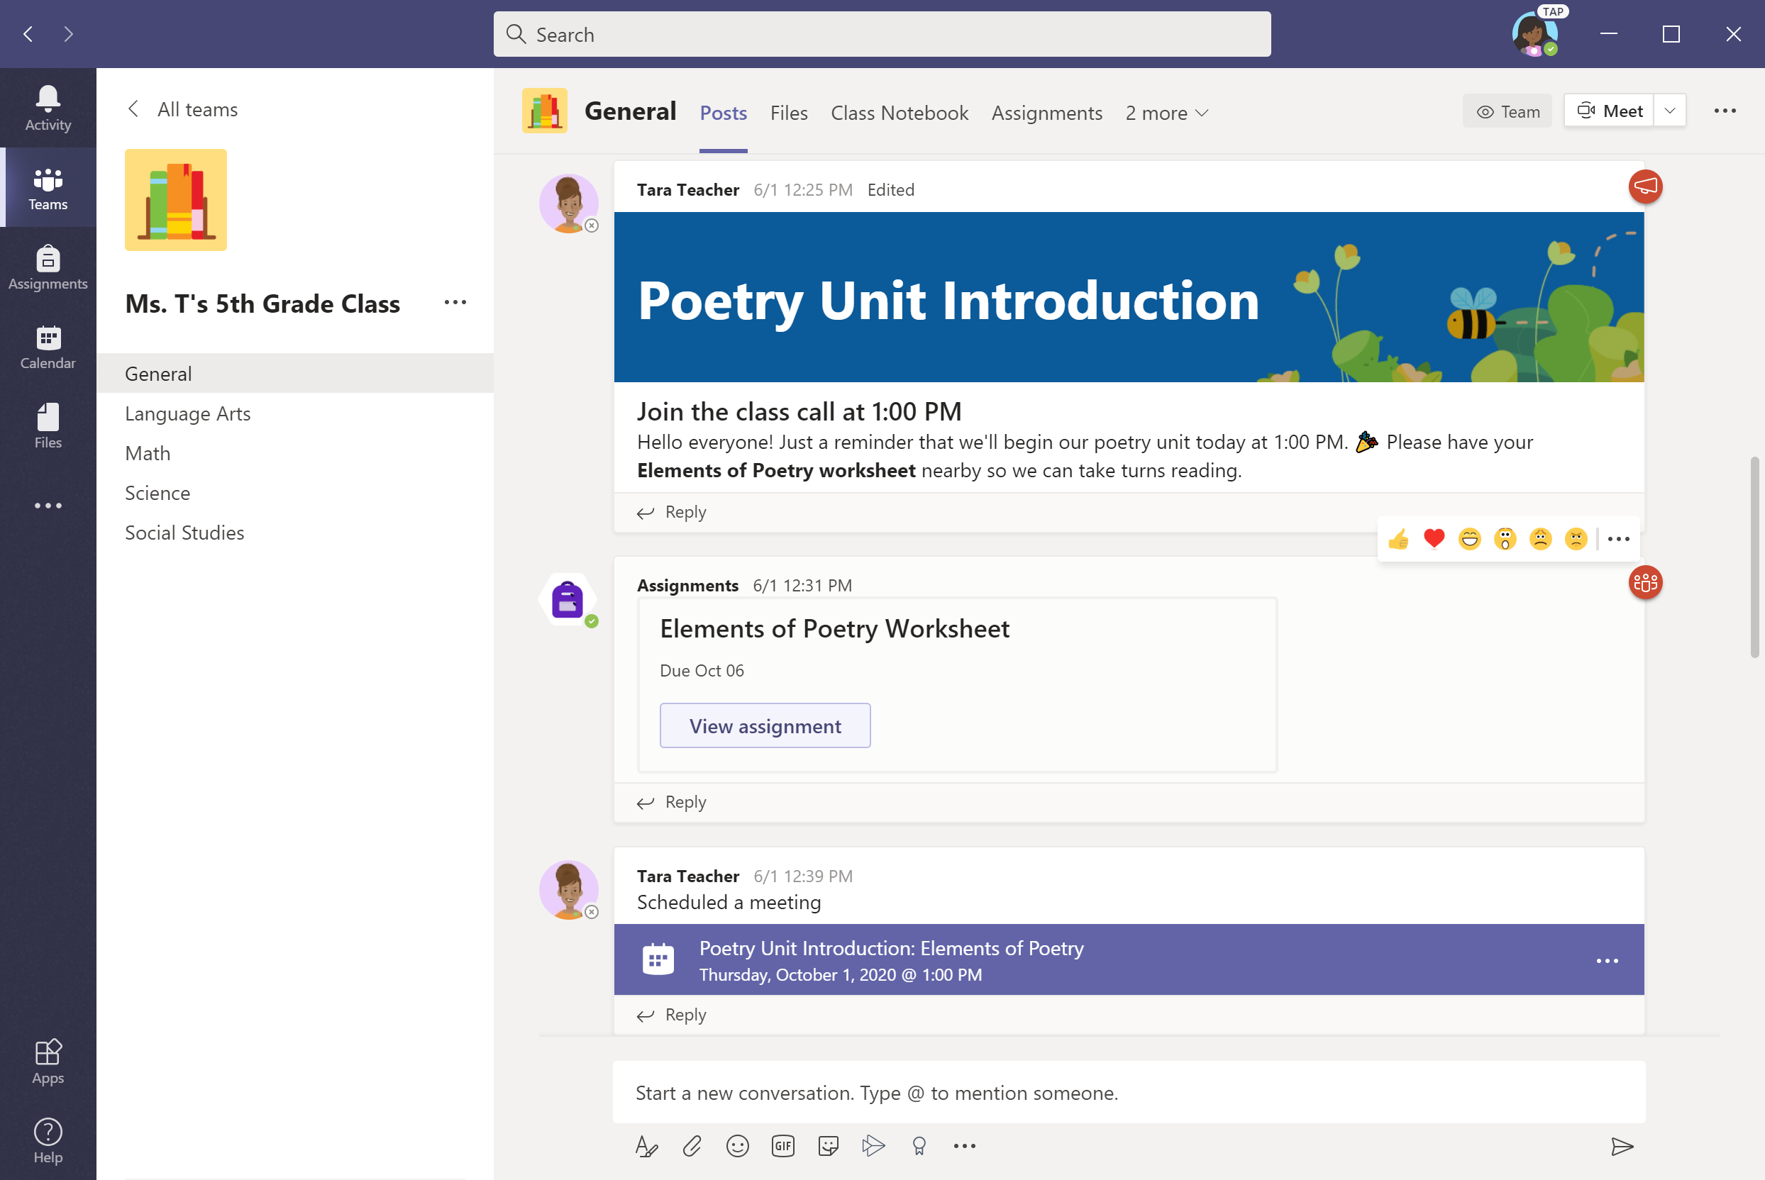
Another option for turning in assignments: View assignments from the Posts tab in the General channel.
Notes:
Box focus in on ‘view assignment’

Slide 43
To upload work, select + Add work. Proceed as shown in previous slides.

Slide 44
Attend a virtual class
Chapter 2
How to help your student use Teams
Join a class team
View and turn in assignments
Attend a virtual class
Find grades
Chat with teachers and classmates

Slide 45
Your student can attend class and customize their virtual experience with video & microphone settings.

Slide 46
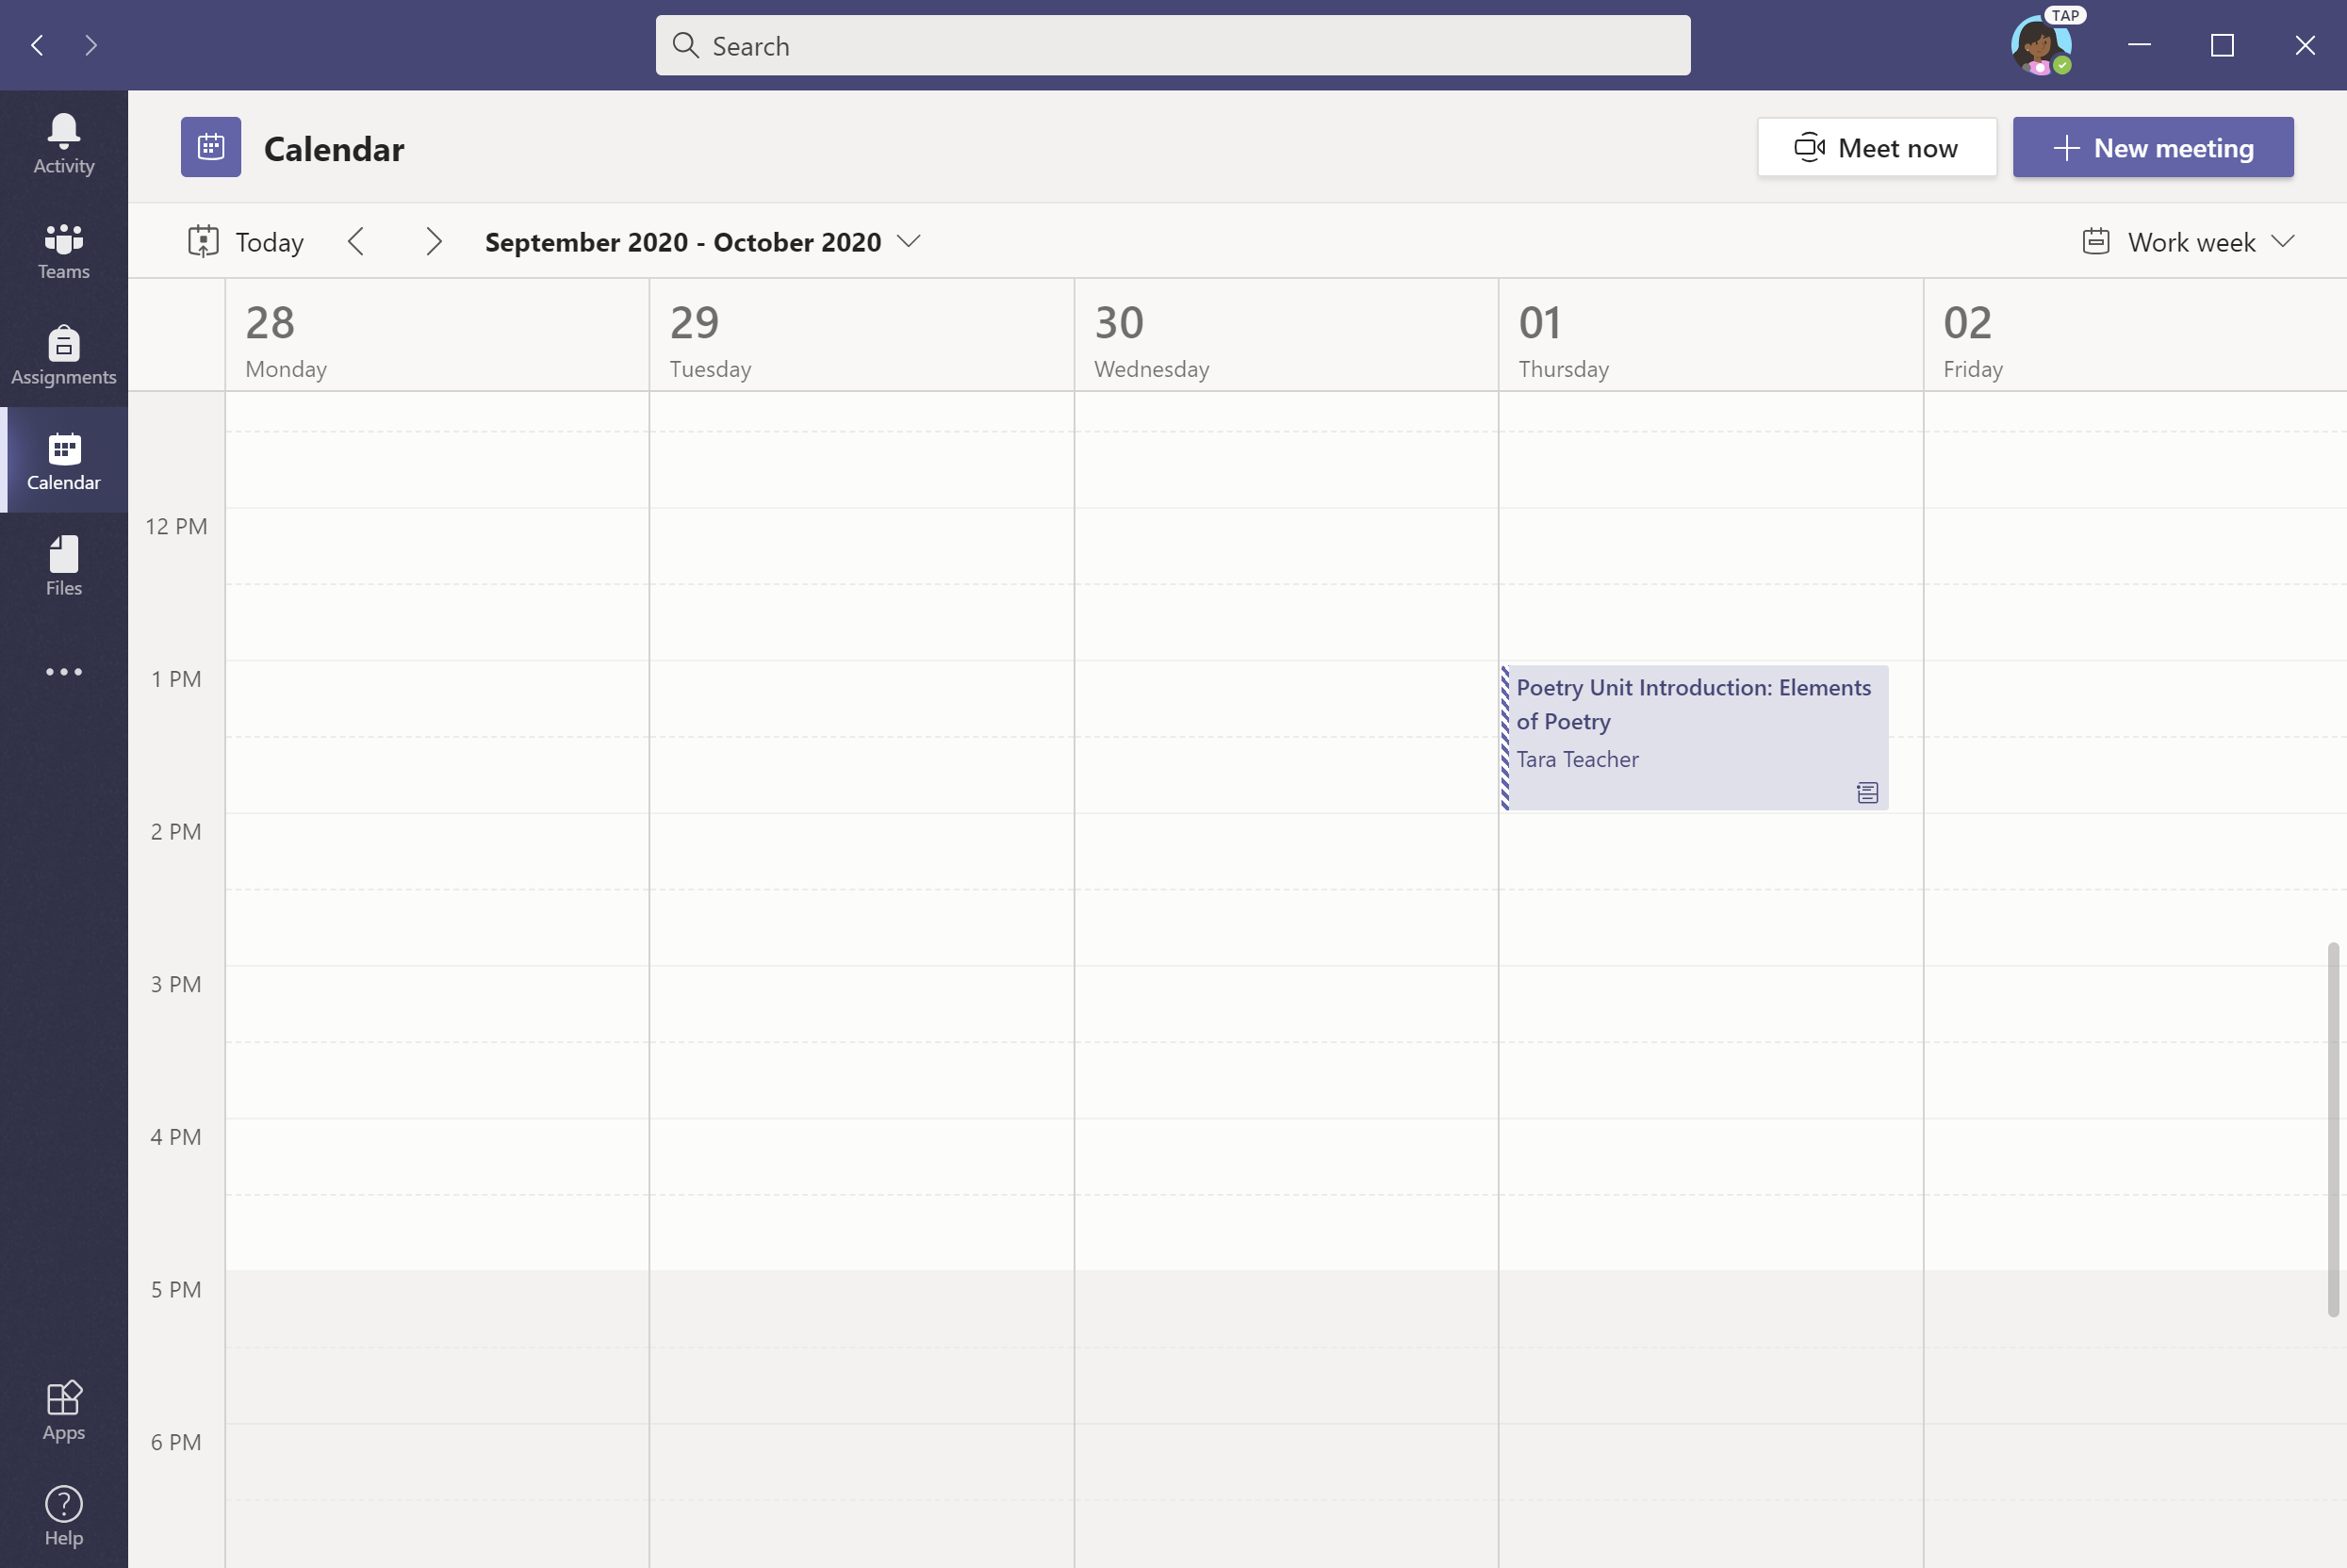
Click on Calendar in the menu bar and select the class meeting.

Slide 47
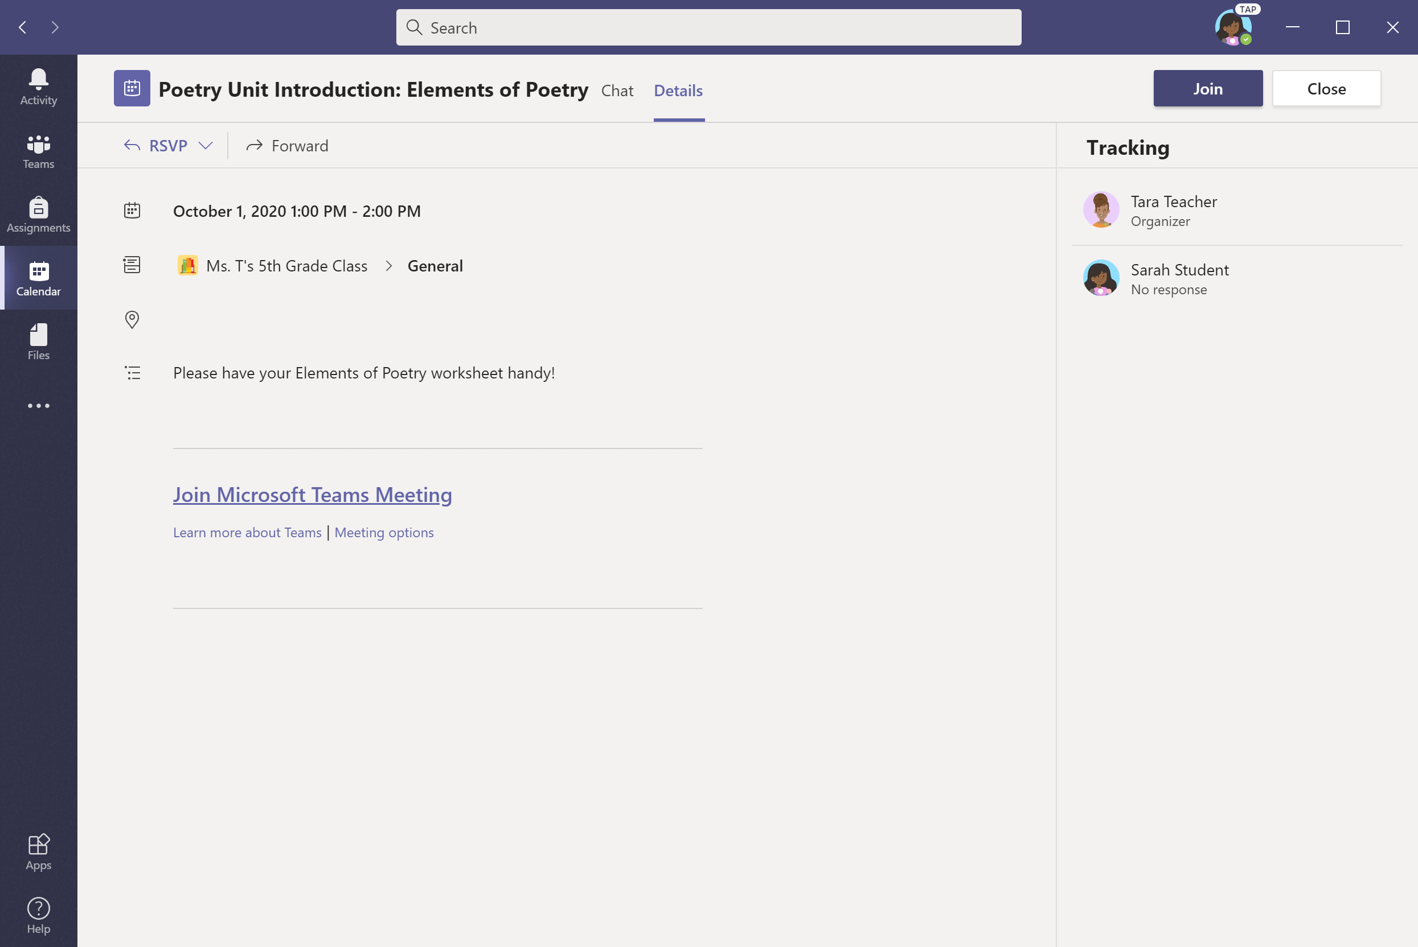
Click Join.

Slide 48
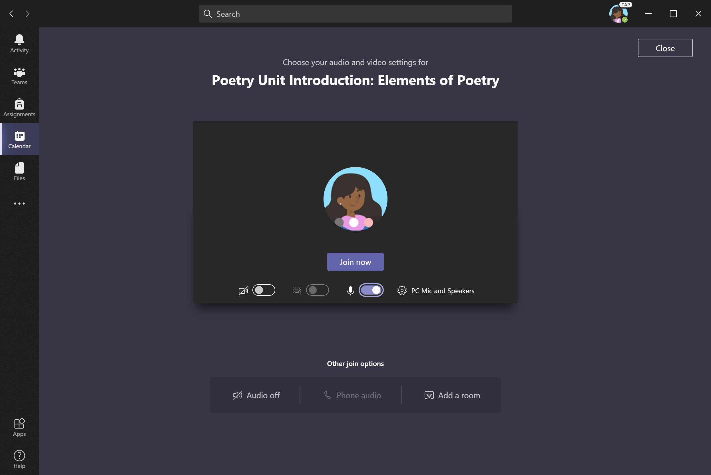
Turn video camera and microphone on/off as appropriate. Click Join now.
Note: Before joining the meeting, your student might enter a virtual lobby where they will wait until the teacher starts the meeting.
This is a new feature we’re introducing to help teachers control when the meeting starts. Check with your student’s teacher if you have any questions.

Slide 49
Find grades
Chapter 2
How to help your student use Teams
Join a class team
View and turn in assignments
Attend a virtual class
Find grades
Chat with teachers and classmates

Slide 50
You and your student can use Teams to keep tabs on assignment status and easily find grades in this quick-view list.

Slide 51
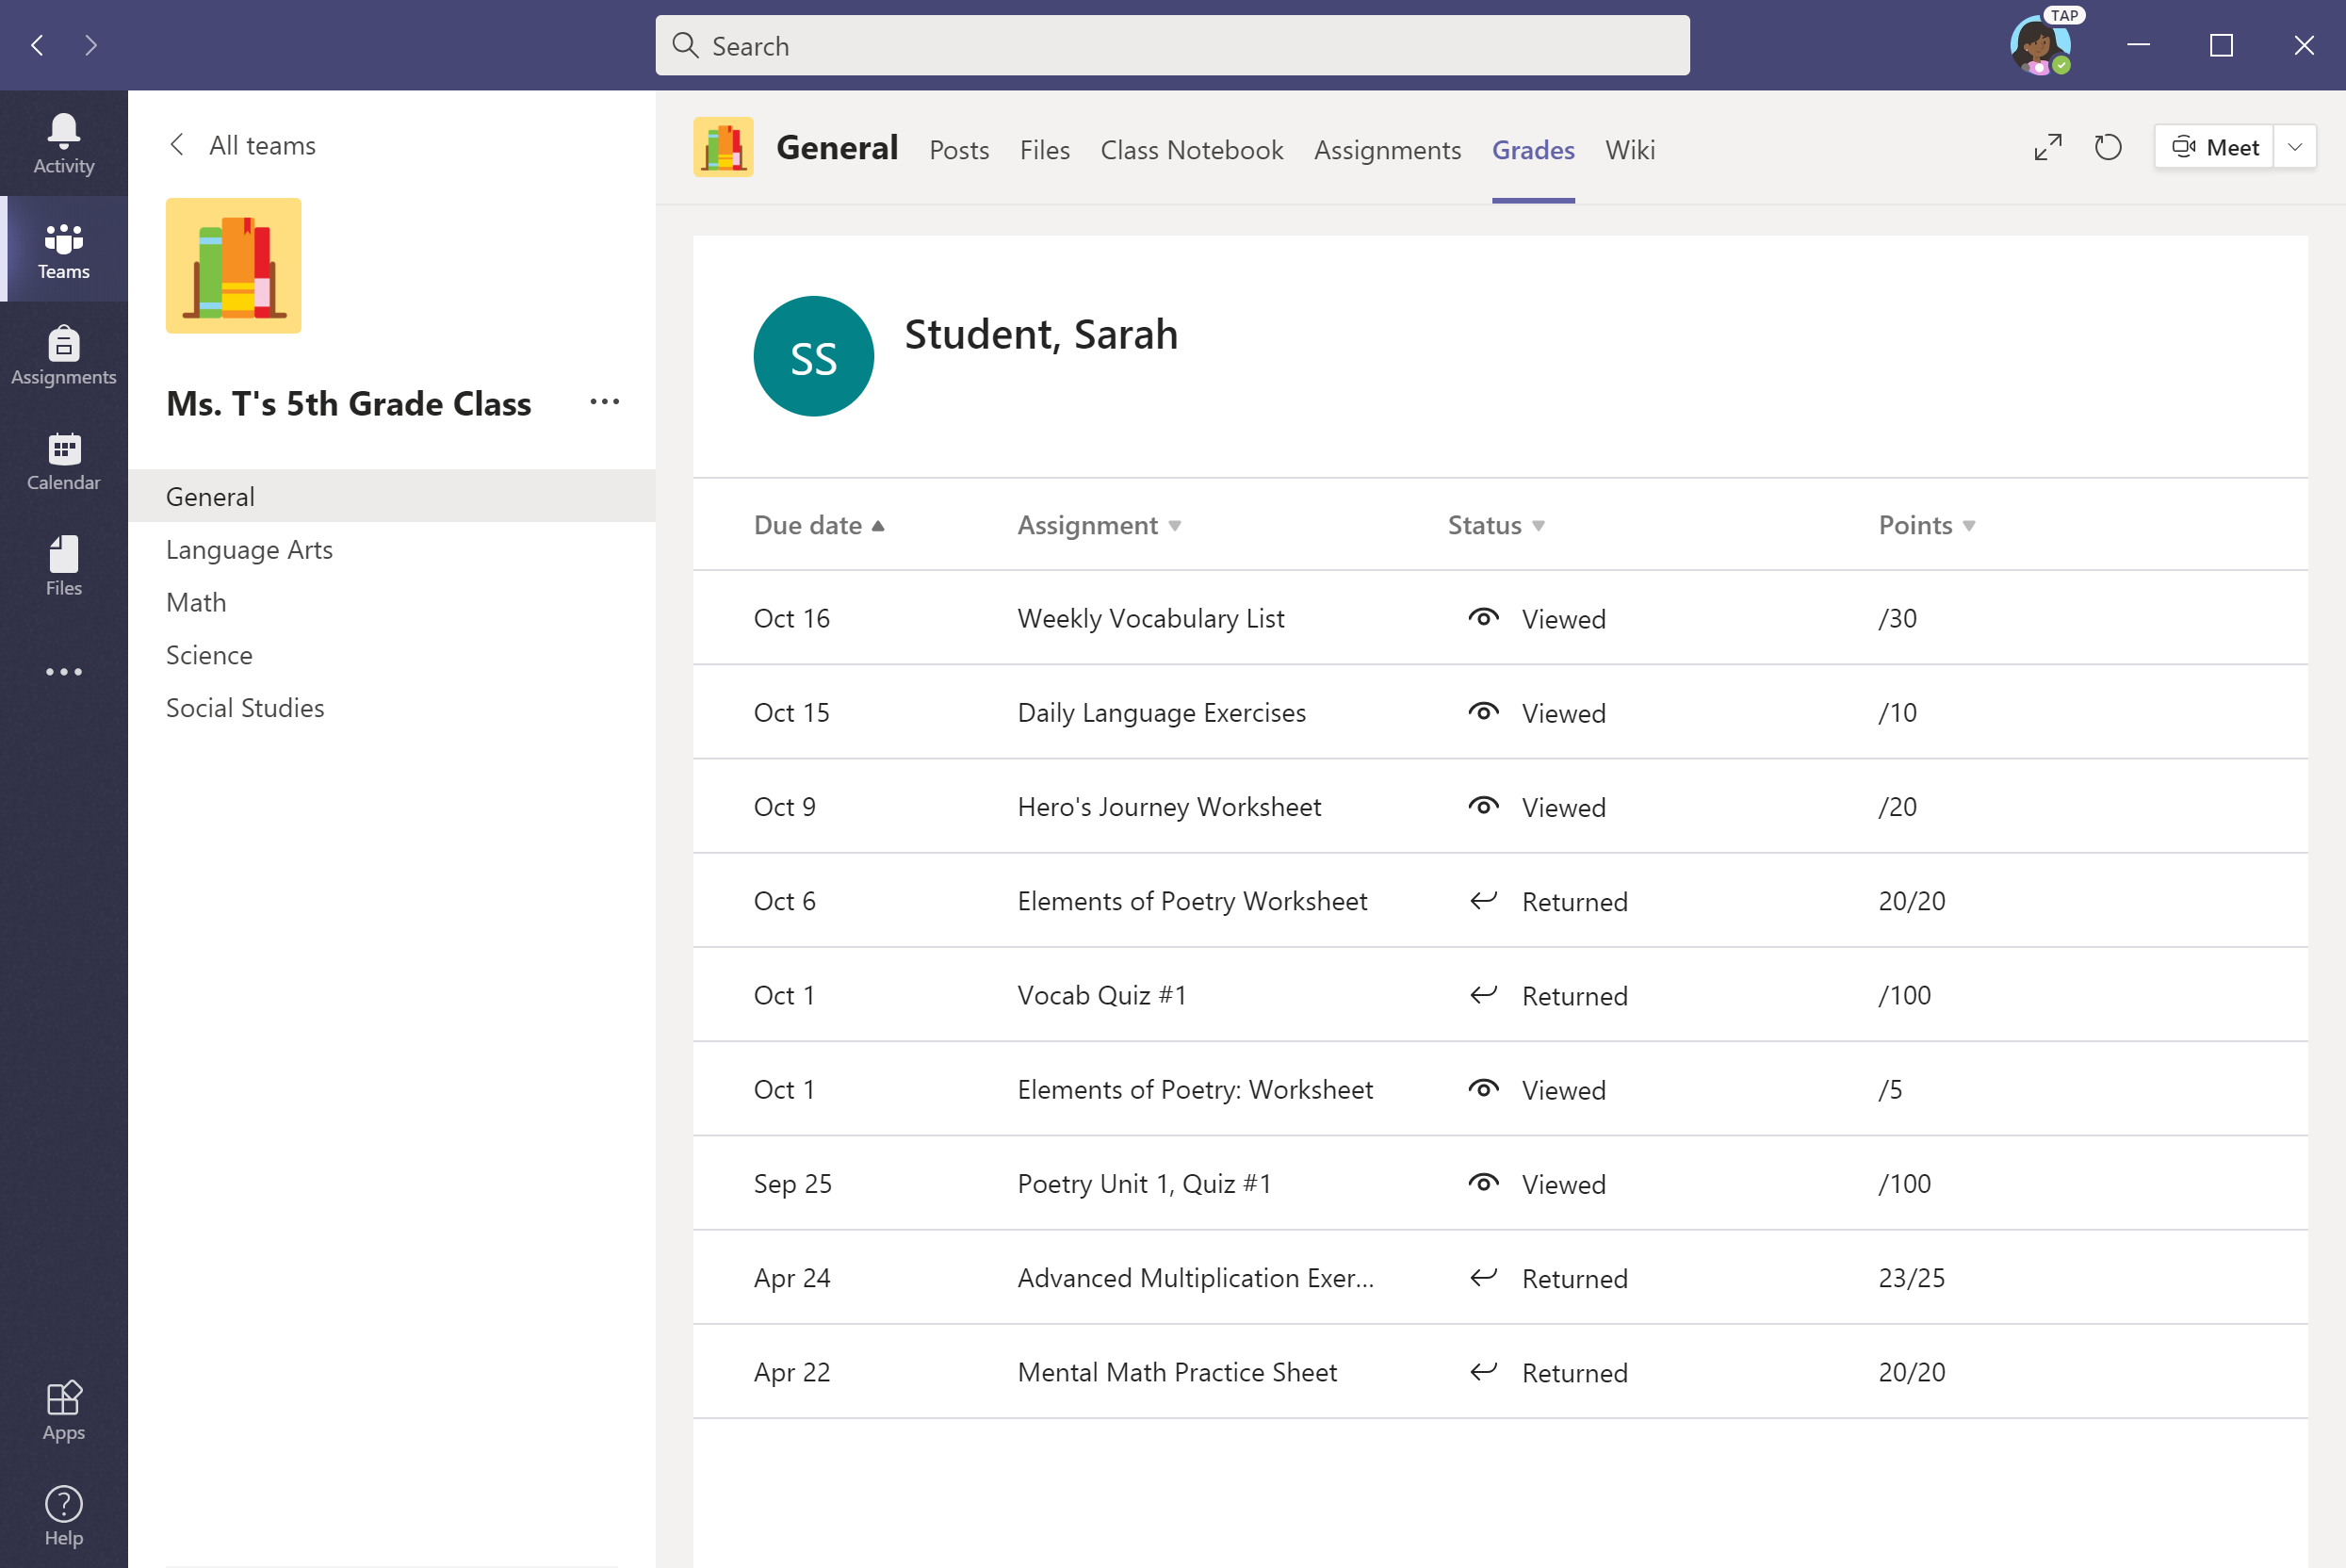
Select the Grades tab in the General channel to view status and grades for assignments.

Slide 52
Chat with teachers and classmates
Chapter 2
How to help your student use Teams
Join a class team
View and turn in assignments
Attend a virtual class
Find grades
Chat with teachers and classmates

Slide 53
If your school implements Chat, your student can chat 1-on-1 or collaborate
with a small group.
Chat availability varies by school district. Not all schools make it available.
Please check with your student’s teacher if you have questions.

Slide 54
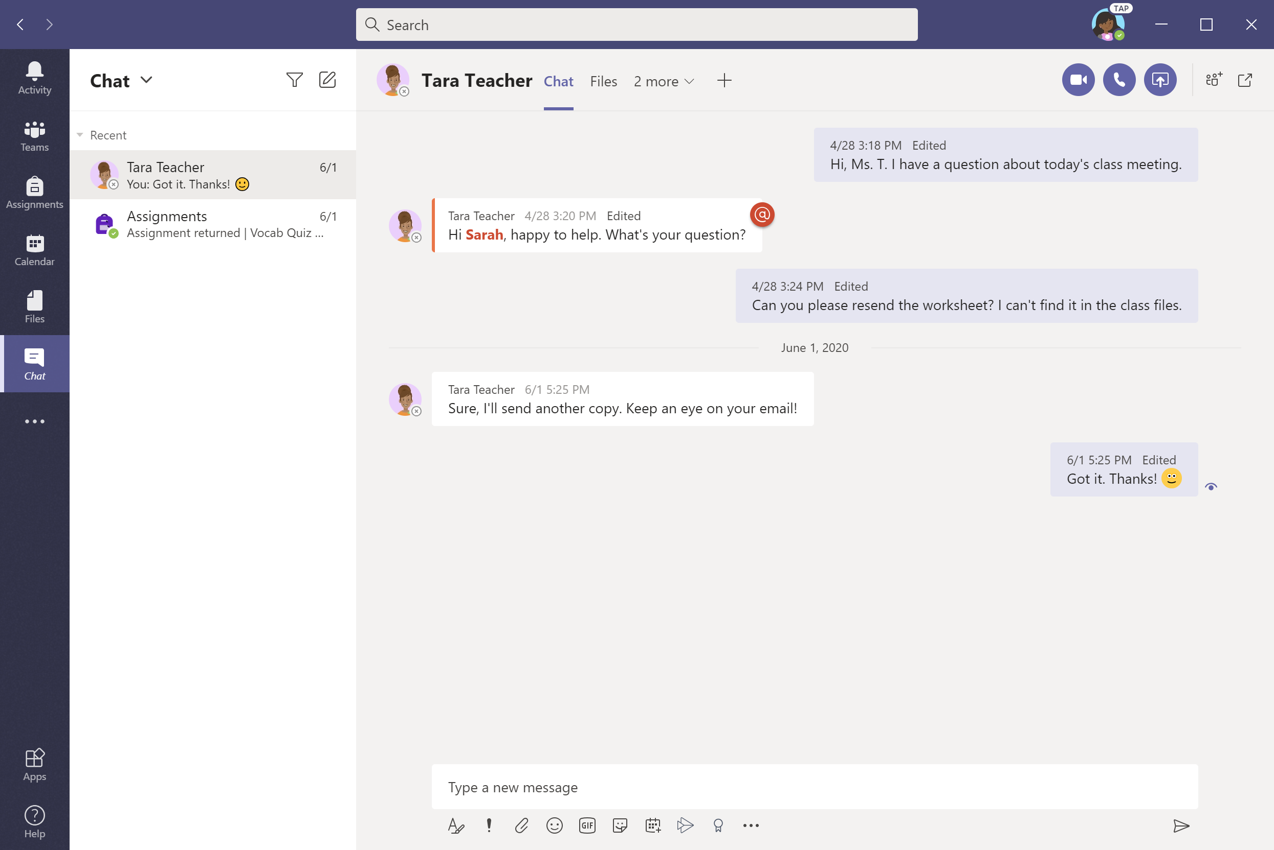
Start a chat by clicking on Chat in the left panel.

Slide 55
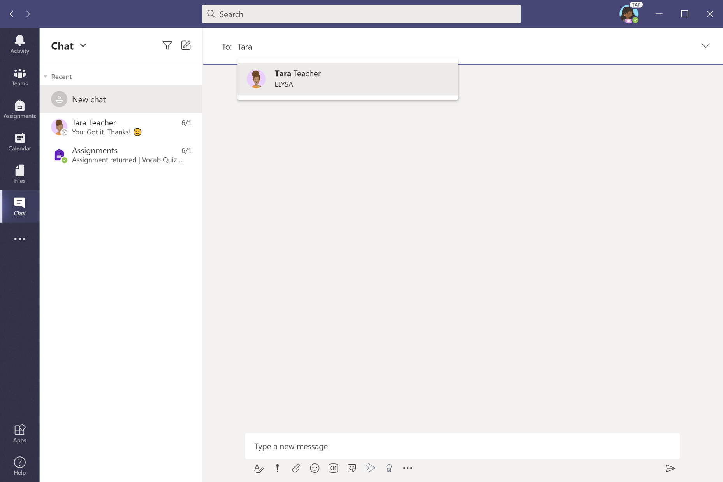
Click the message icon and start typing name(s) in the To: field.
This example shows the student reaching out directly to the teacher in a 1:1 conversation.

Slide 56
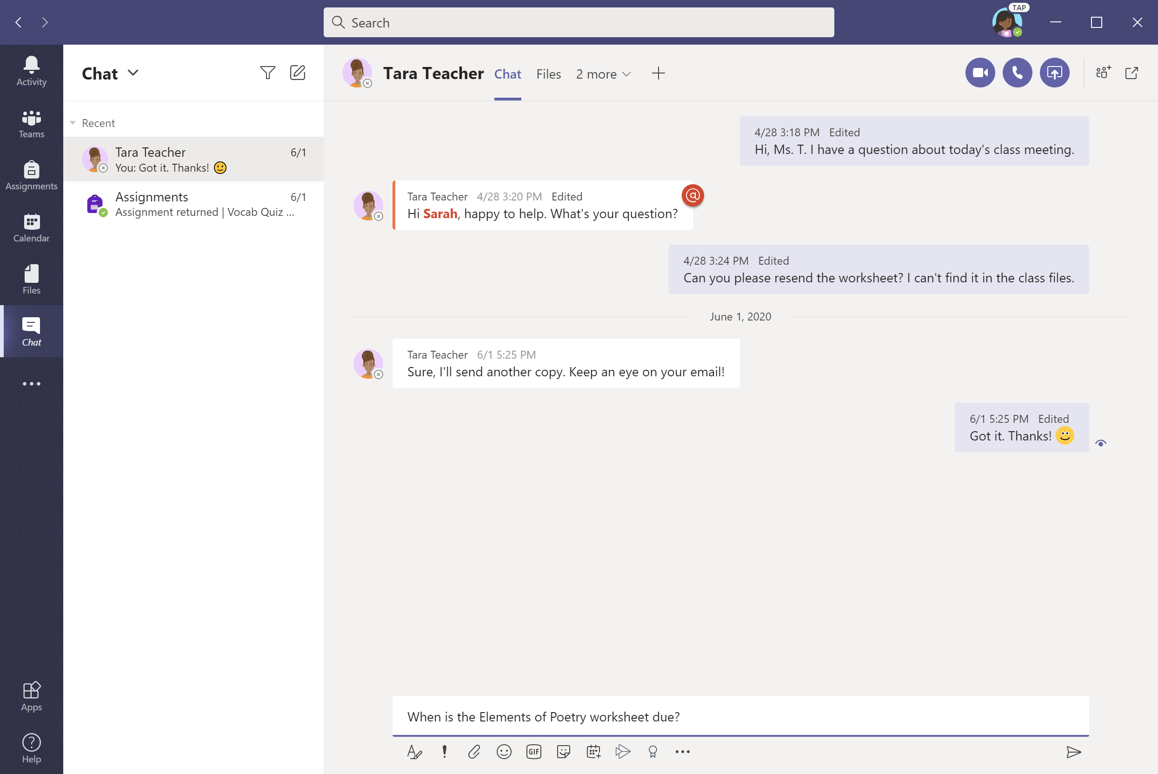
Write your message in the white box and click the send icon.

Slide 57
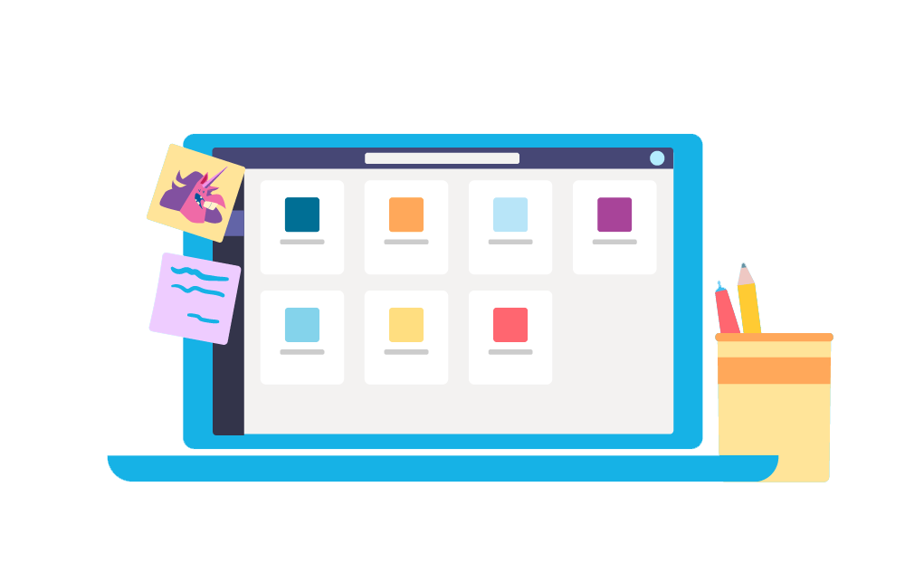
FAQ & Troubleshooting
FAQ & Troubleshooting
My student’s login isn’t working.
I can’t find my student’s class during set-up.
My student’s assignments are missing.
My student missed a class—what now?
What if I have more than one student using Teams on one device?
What do I do if we have low internet bandwidth?
Audio troubleshooting
Additional resources

Slide 58
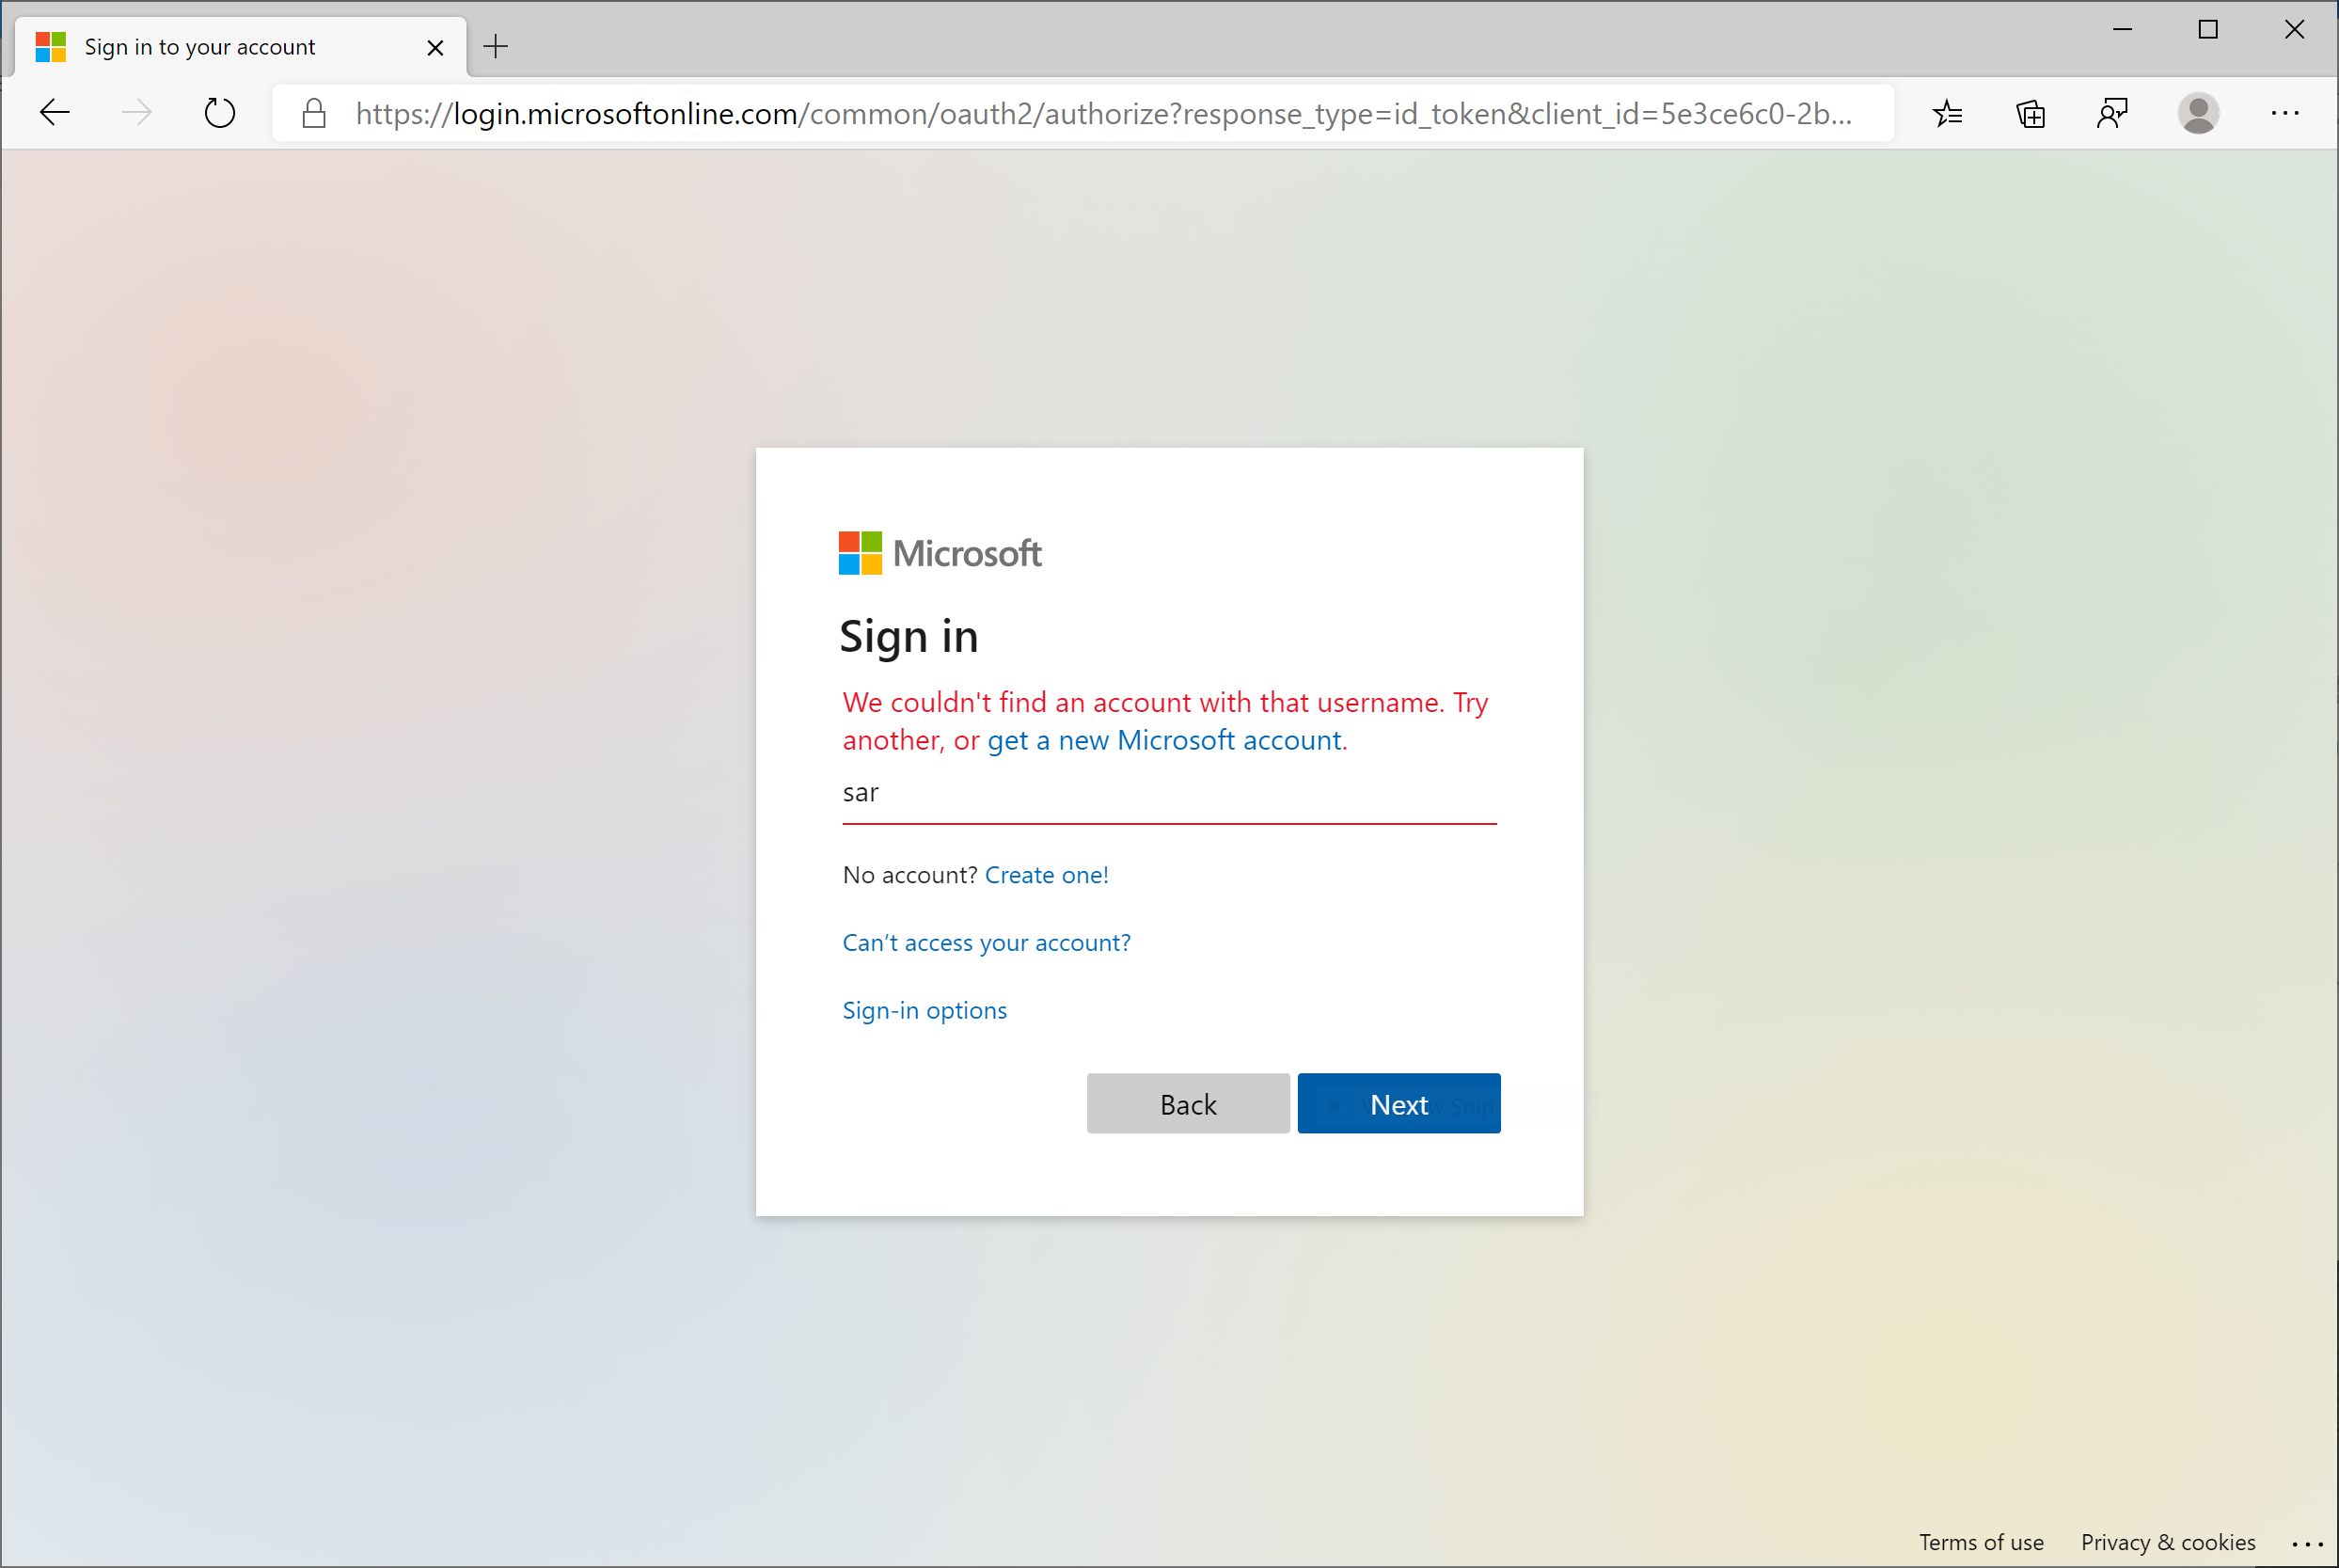
My student’s login isn’t working.
The login information may not be accurate or there might be some other issues with the accounts in your student's school. Contact your student’s teacher or school district with questions.

Slide 59
2. I can’t find my student’s class during set-up.
If you don’t see your student’s classes after you log in, the teacher may have invited you to join your class team with:
A join code. From the Teams page, select Join team
and enter the code.
A unique link. Ask your student to check their email.

Slide 60
3. My student’s assignments are missing.
Check the Assignments tab. If you don’t see any assignments, have your student email the teacher.

Slide 61
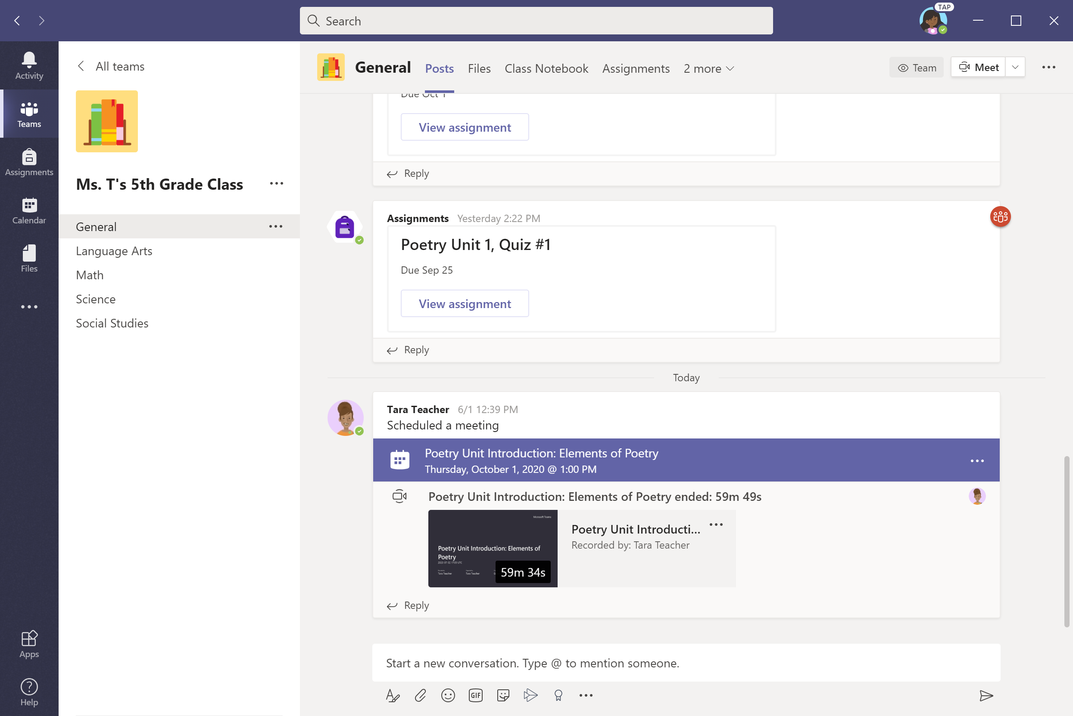
4. My student missed a class—what now?
Read any new posts in the class team channel.
Check for a recording of the class meeting in the team channel and watch the meeting.
Check in with the teacher for additional information.

Slide 62
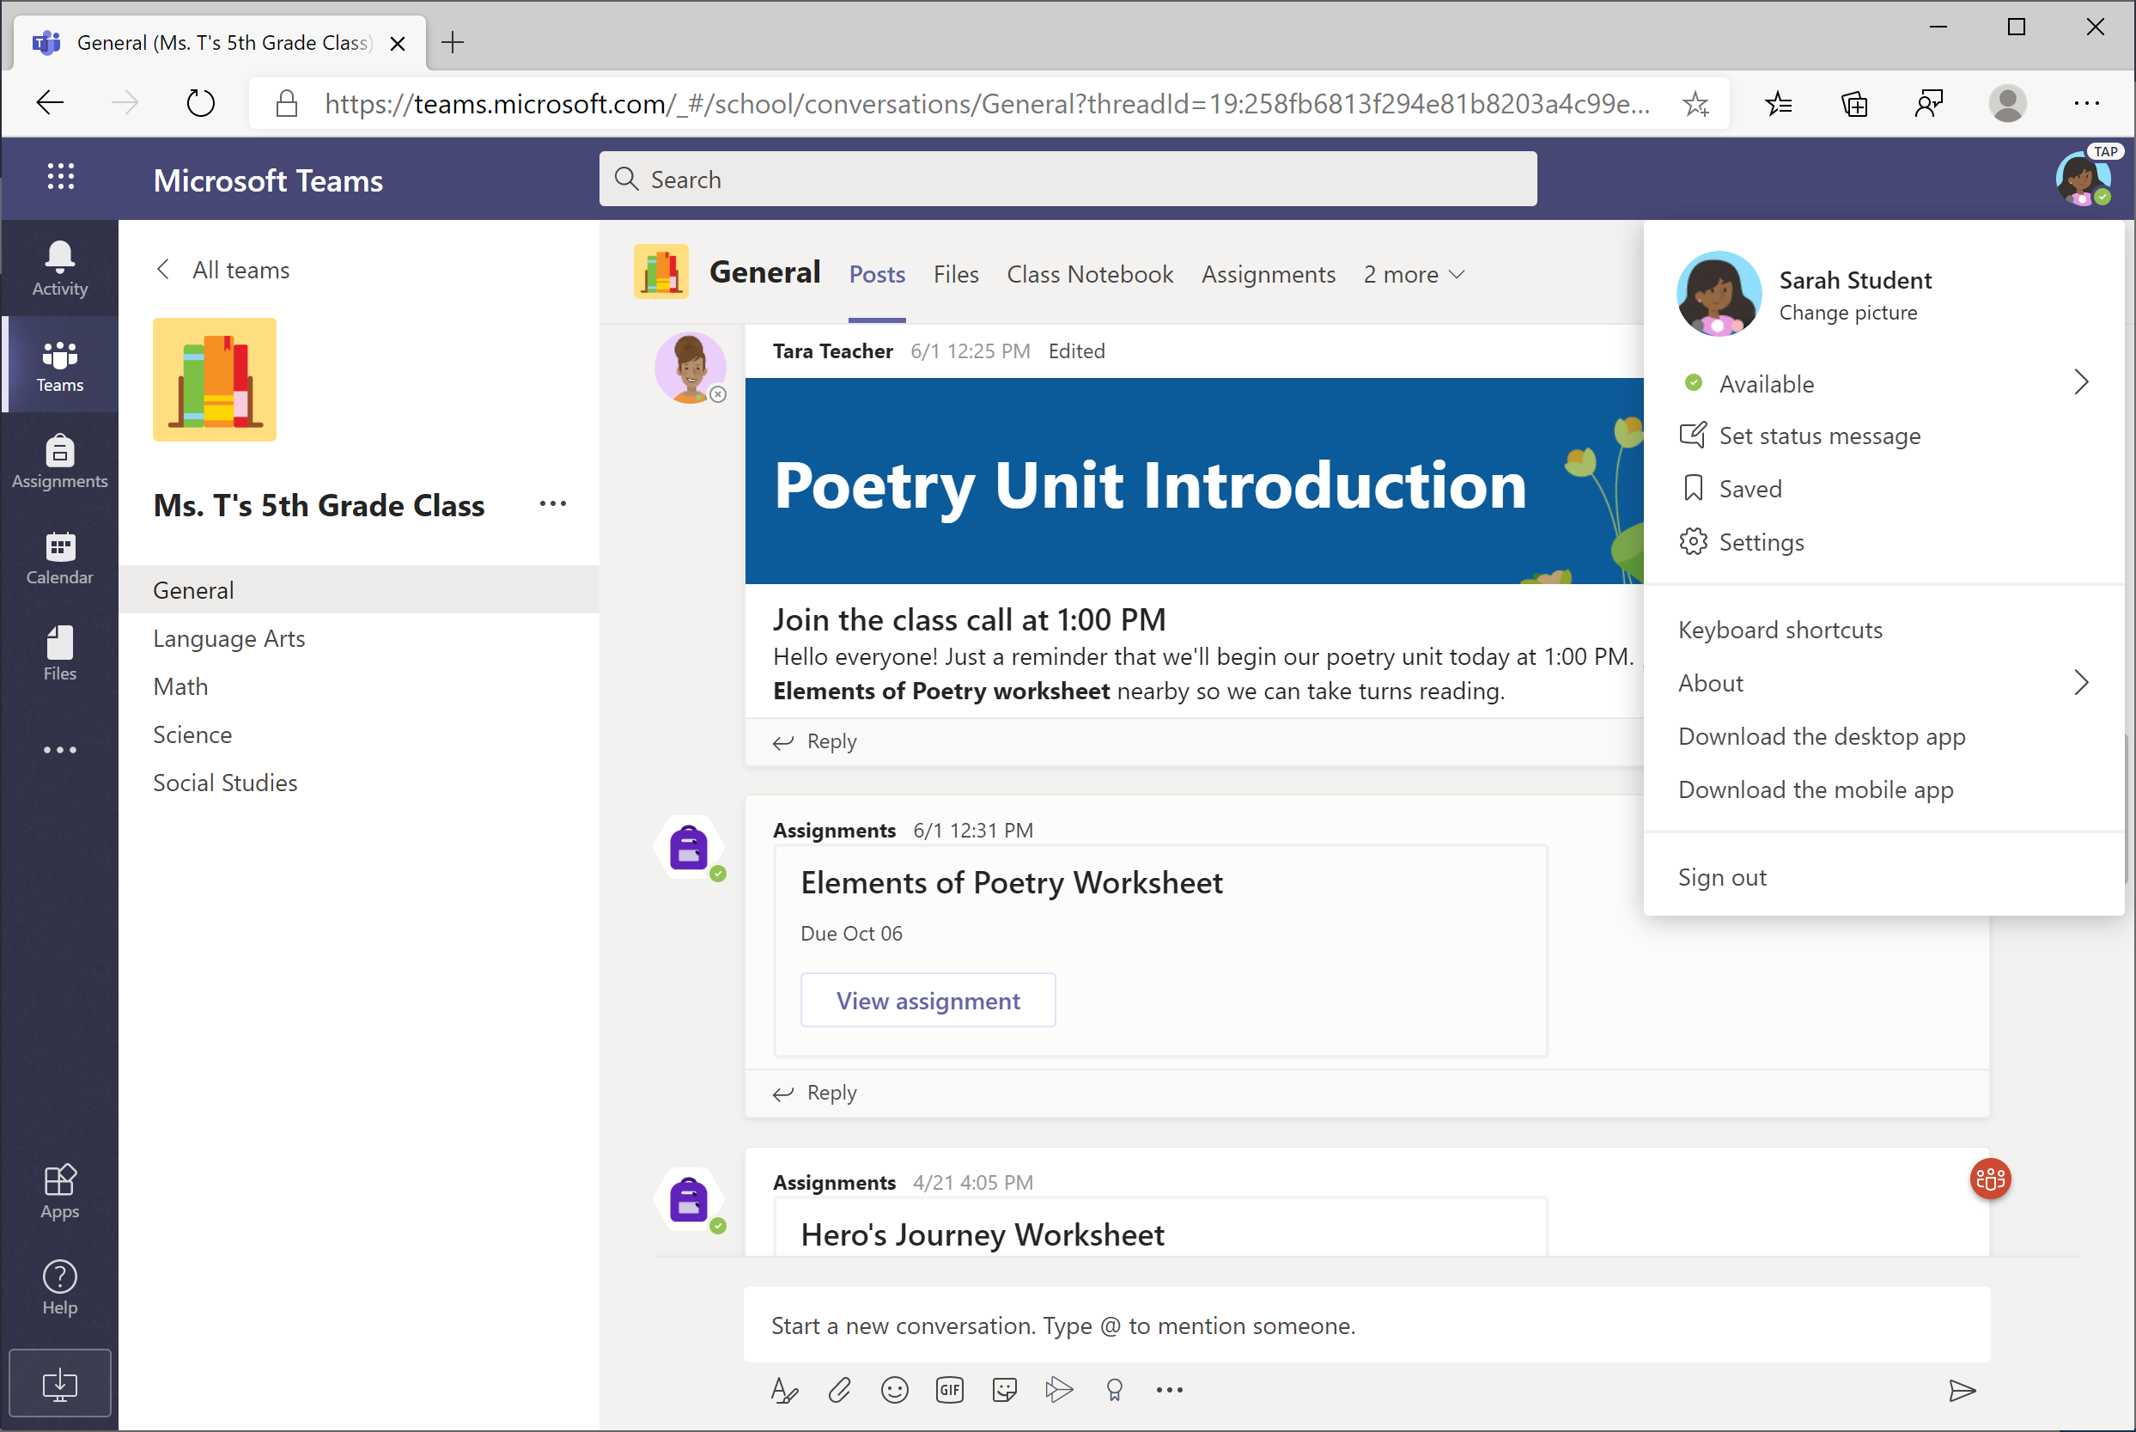
5. What if I have more than one student using Teams on one device?
Each student is able to log in to their own Teams account with their unique username and password.
When one student is done with their Teams work, click on their icon in the top-right corner and select Sign out. The next student can then log in.

Slide 63

You can also create multiple accounts (also called profiles) in the new Edge browser.

Slide 64
6. We are experiencing low internet bandwidth. What can we do?
You can still use Teams when internet bandwidth is low. Teams will work to reduce the amount of video streams automatically.
You can try limiting video usage during live class sessions. Have your student turn on the camera at the beginning of the session to say hello, or have your student only use the camera when they are speaking.

Slide 65

You can also turn off incoming video when bandwidth is low.
Click on the “. . .” (More Options) and select Turn off incoming video.

Slide 66

7. Audio troubleshooting: The teacher can’t hear my student, or my student can’t hear the teacher.
If people in a class meeting can't hear your student, they might be muted or the microphone setting might be incorrect.
Click the microphone icon to turn the mute button on/off.

Slide 67

To change your speaker or microphone settings in a meeting, select the “. . .” (More Options) button from the toolbar. Click Device settings.

Slide 68

Select the speakers and microphone you wish to use.

Slide 69
Additional resources
Additional resources
Help your student successfully navigate online learning through time management, communication, study habits, and motivation best practices:
Tips for successful online learning
Find support articles and troubleshooting assistance:
Microsoft Teams support center

